Slide 1



Applying Object Composition to Build Rich Domain Models
Zoran Horvat
CEO & Principal Consultant, Coding Helmet Consultancy
zh@sysexpand.com
http://codinghelmet.com
zoranh75

Slide 2

https://pluralsight.com/authors/zoran-horvat
zh@sysexpand.com
http://codinghelmet.com
zoranh75

Slide 4
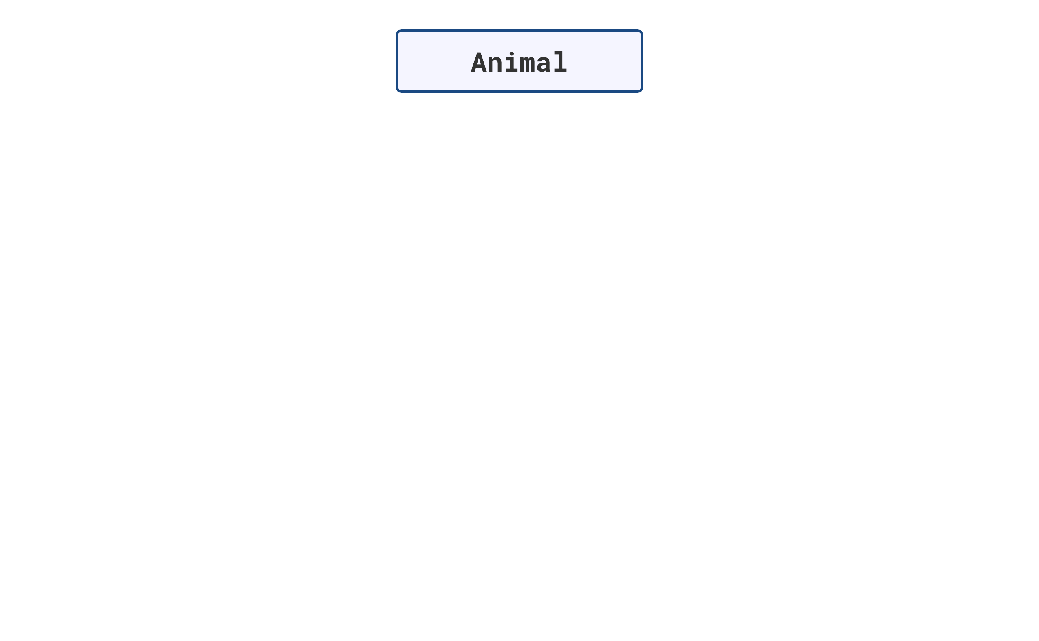

Slide 5
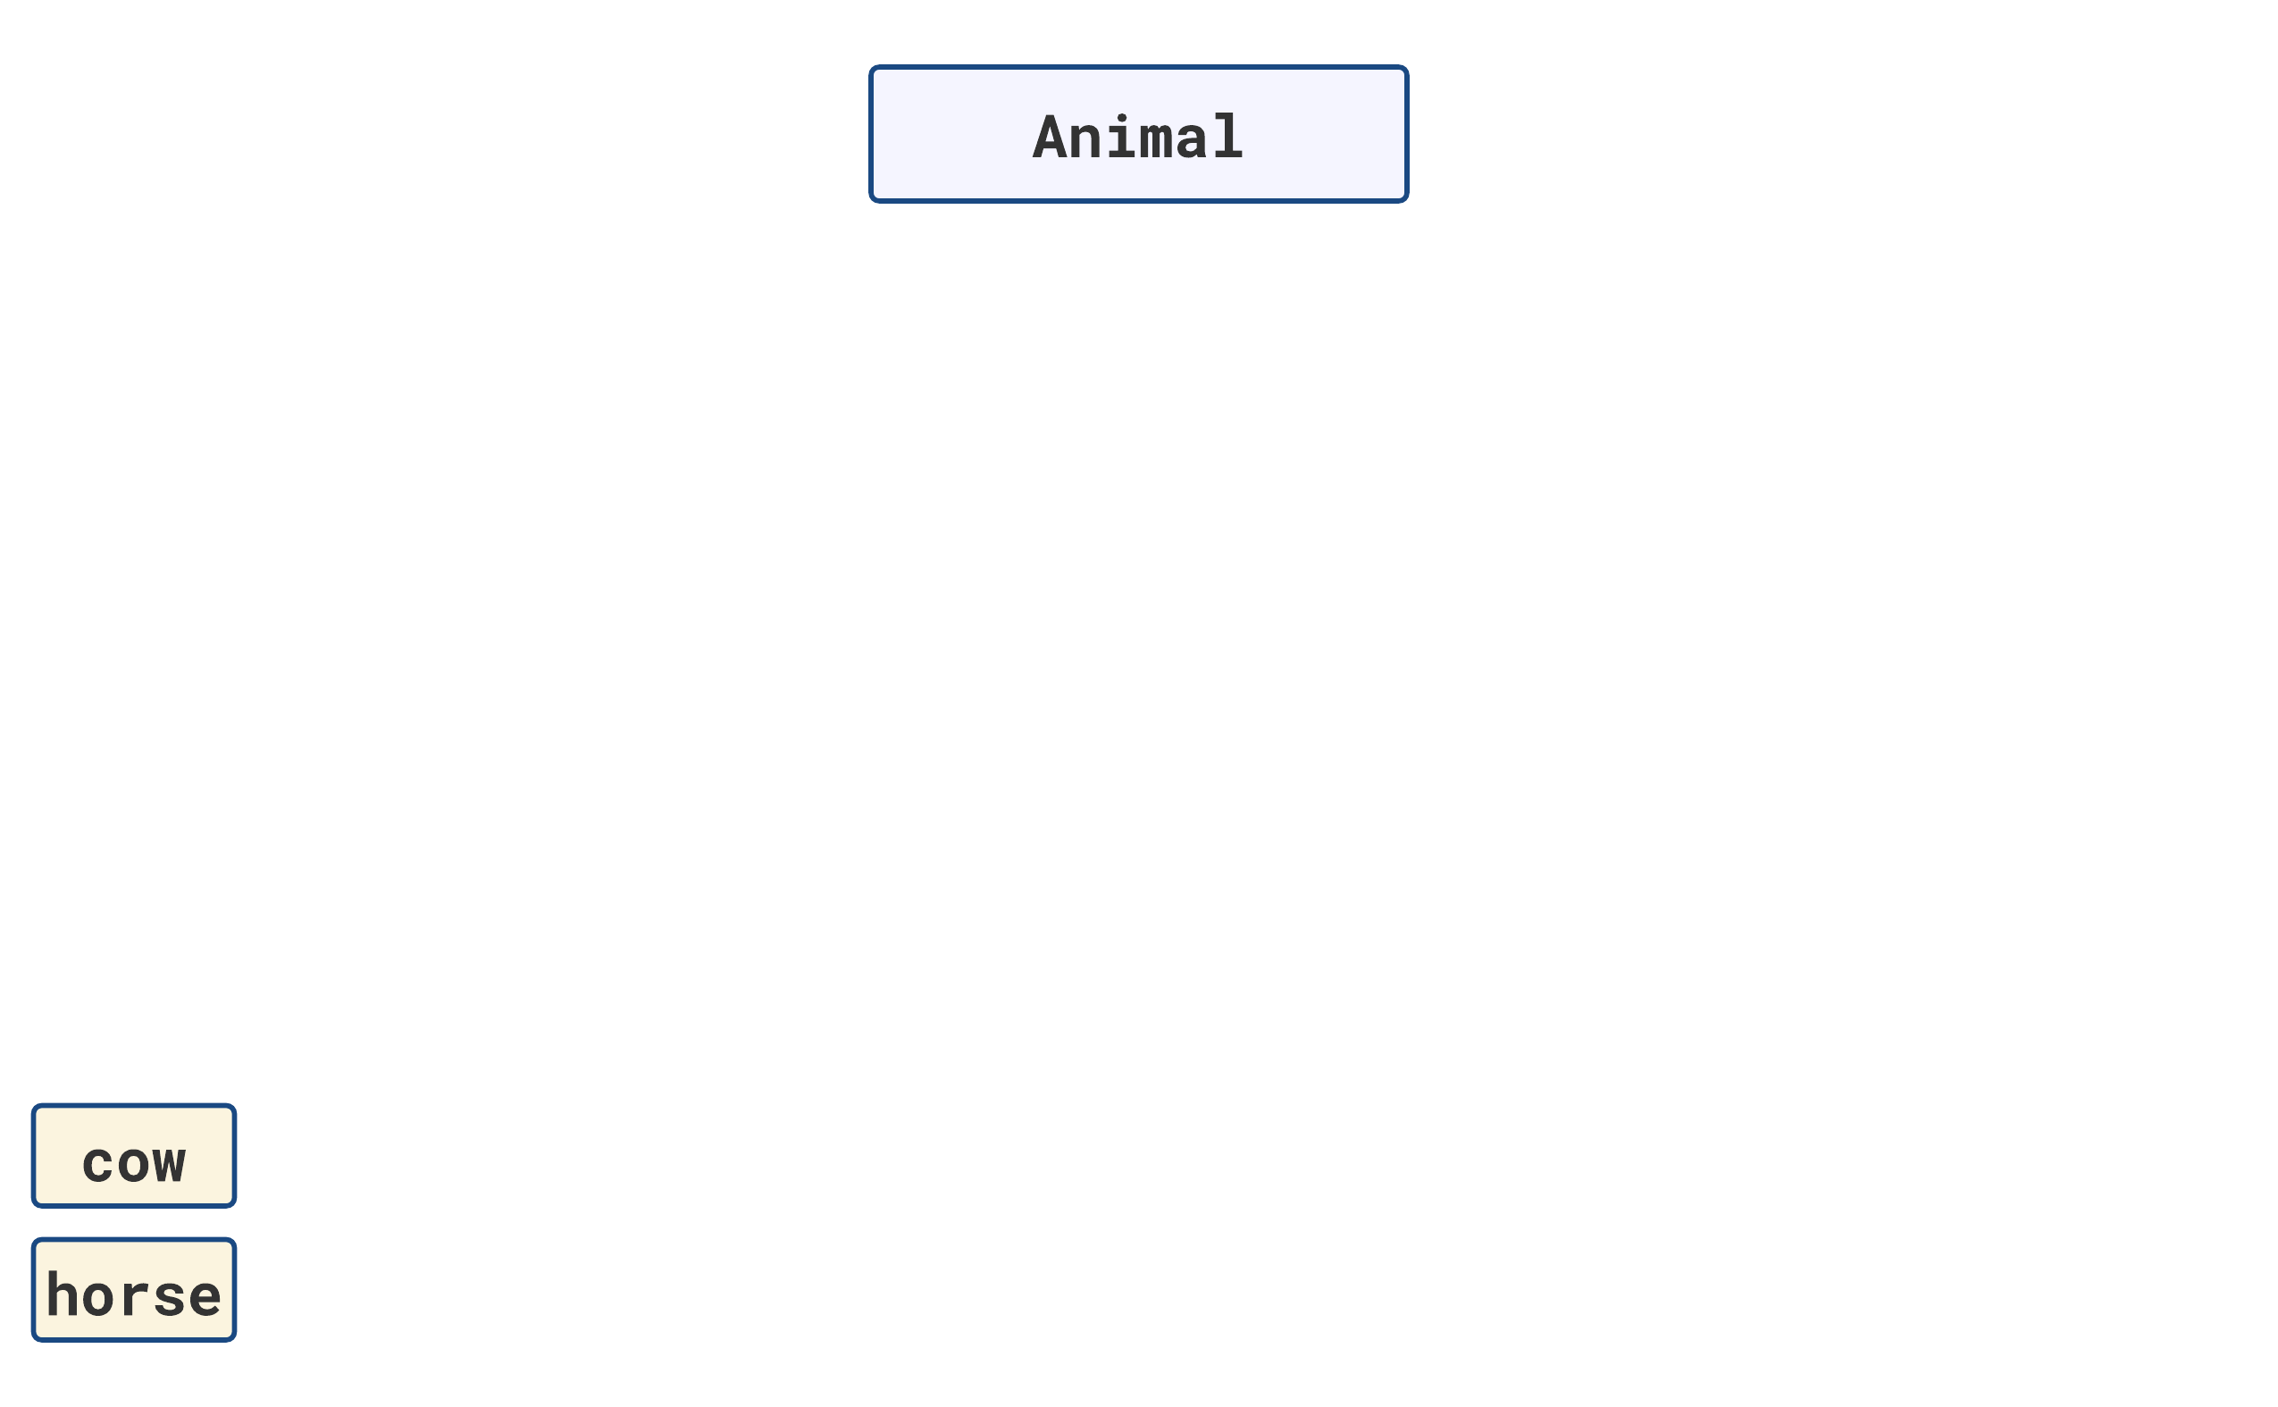

Slide 6
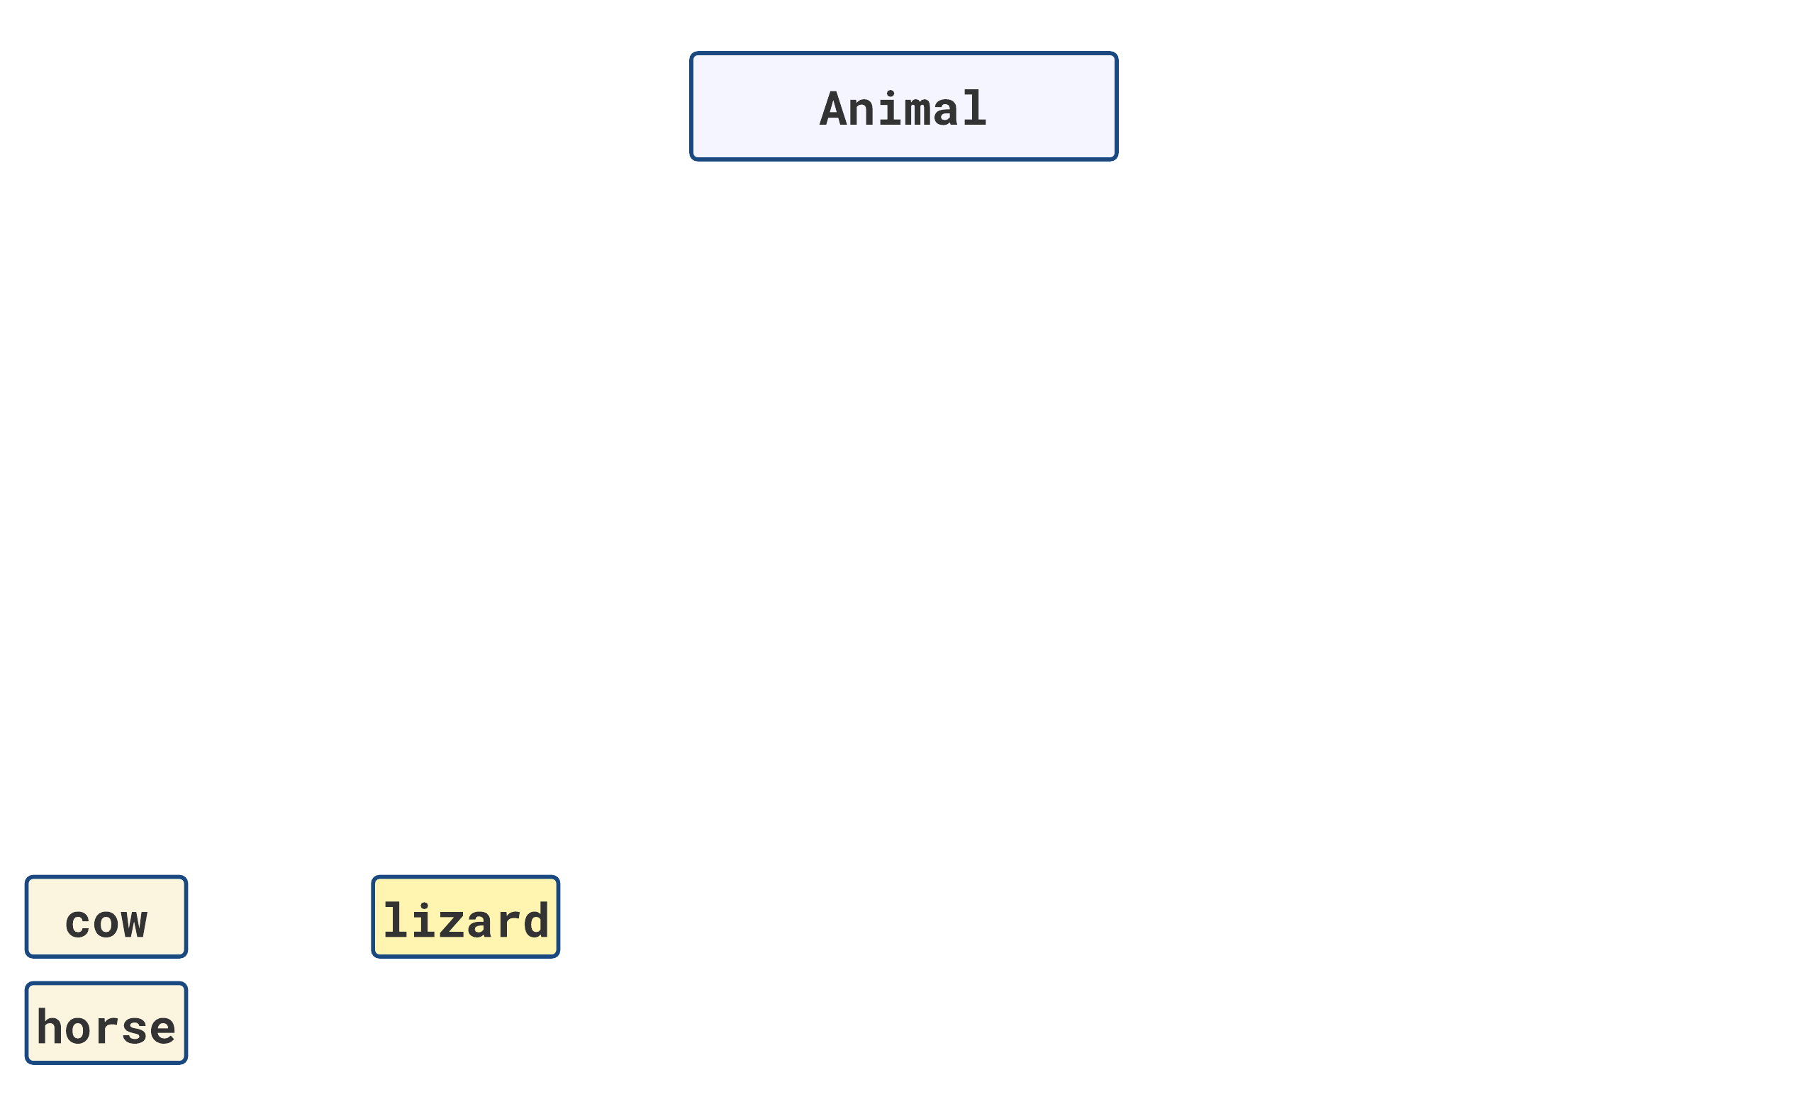

Slide 7
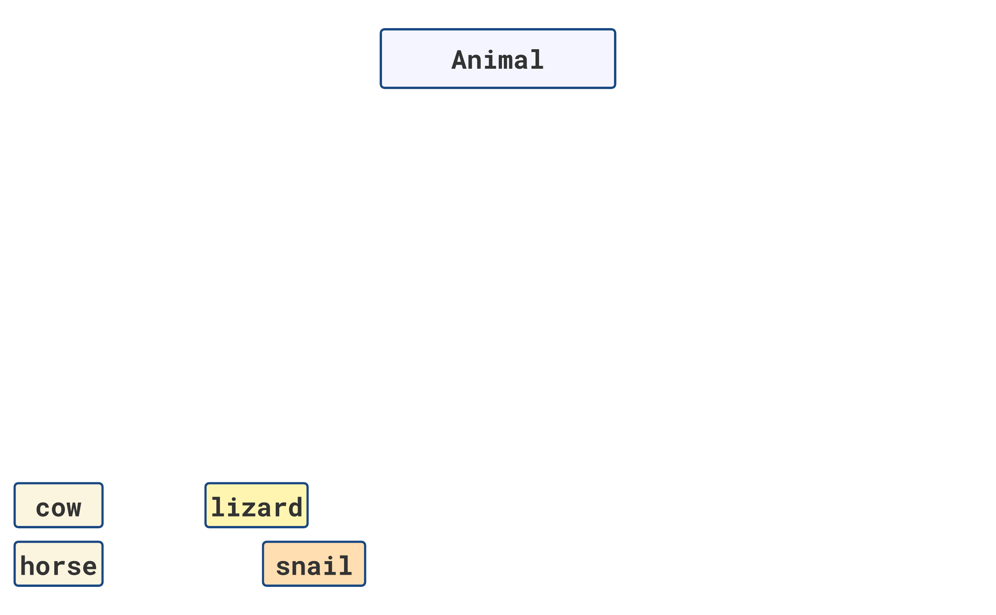

Slide 8
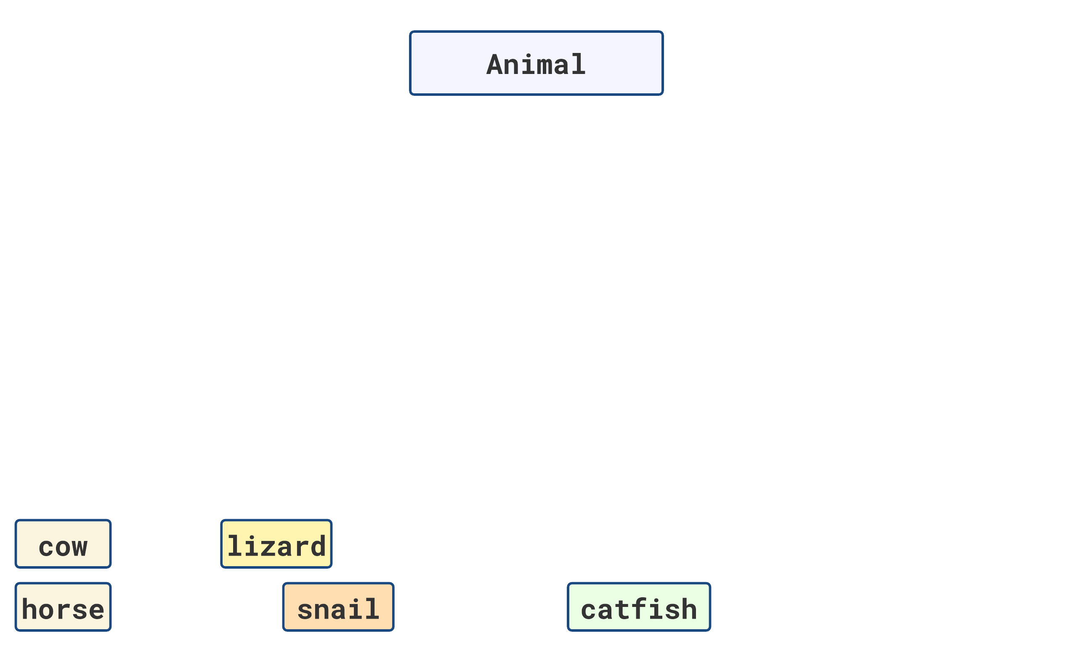

Slide 9
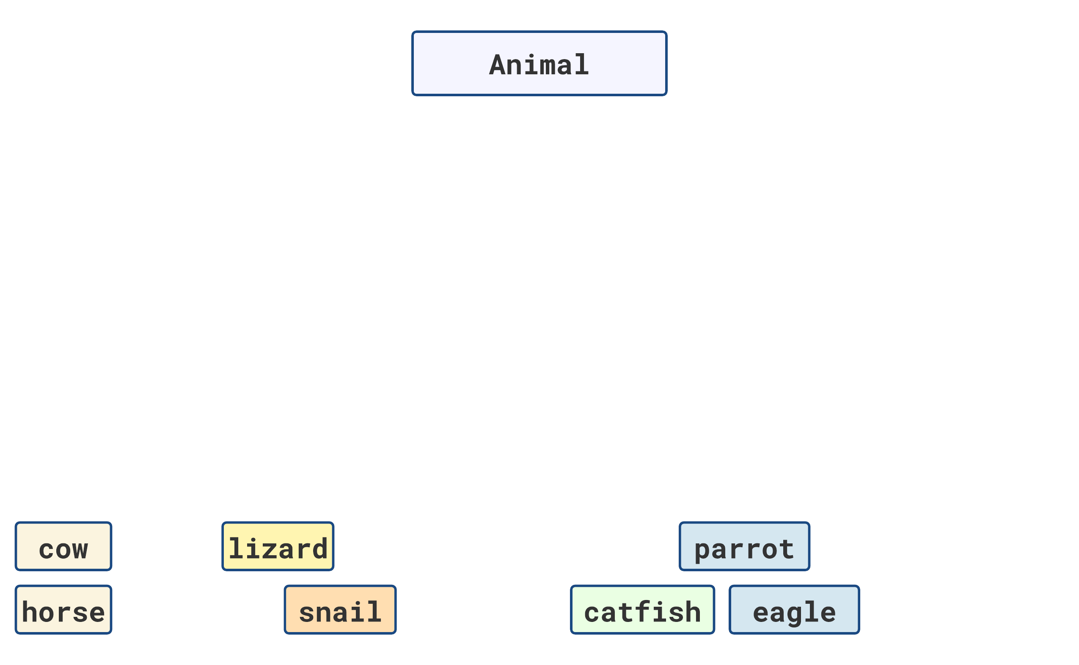

Slide 10
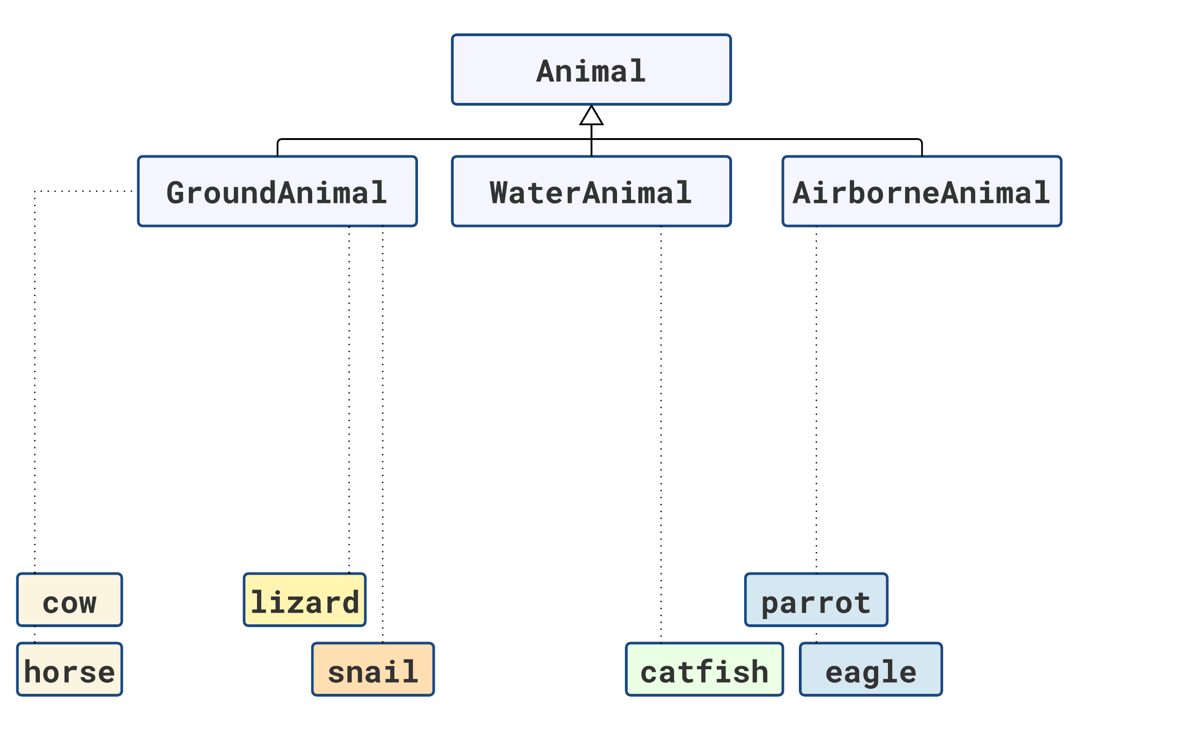

Slide 11
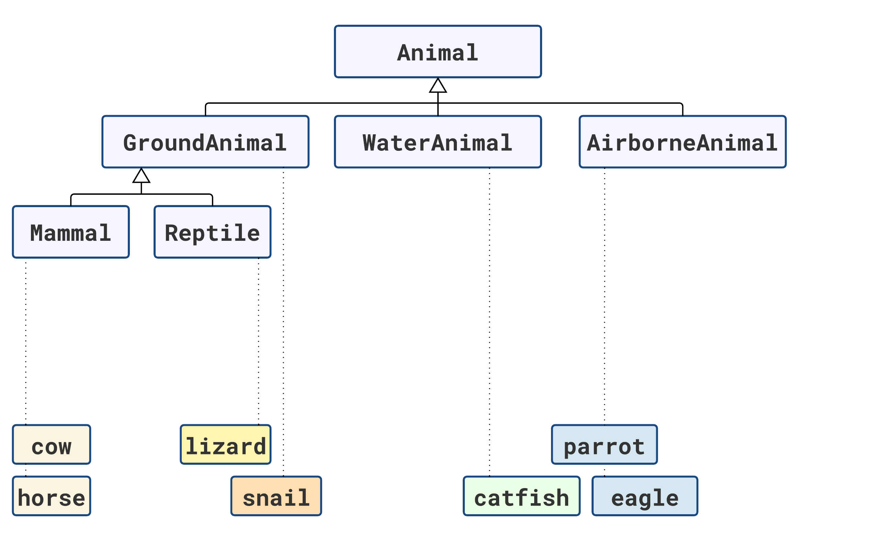

Slide 12
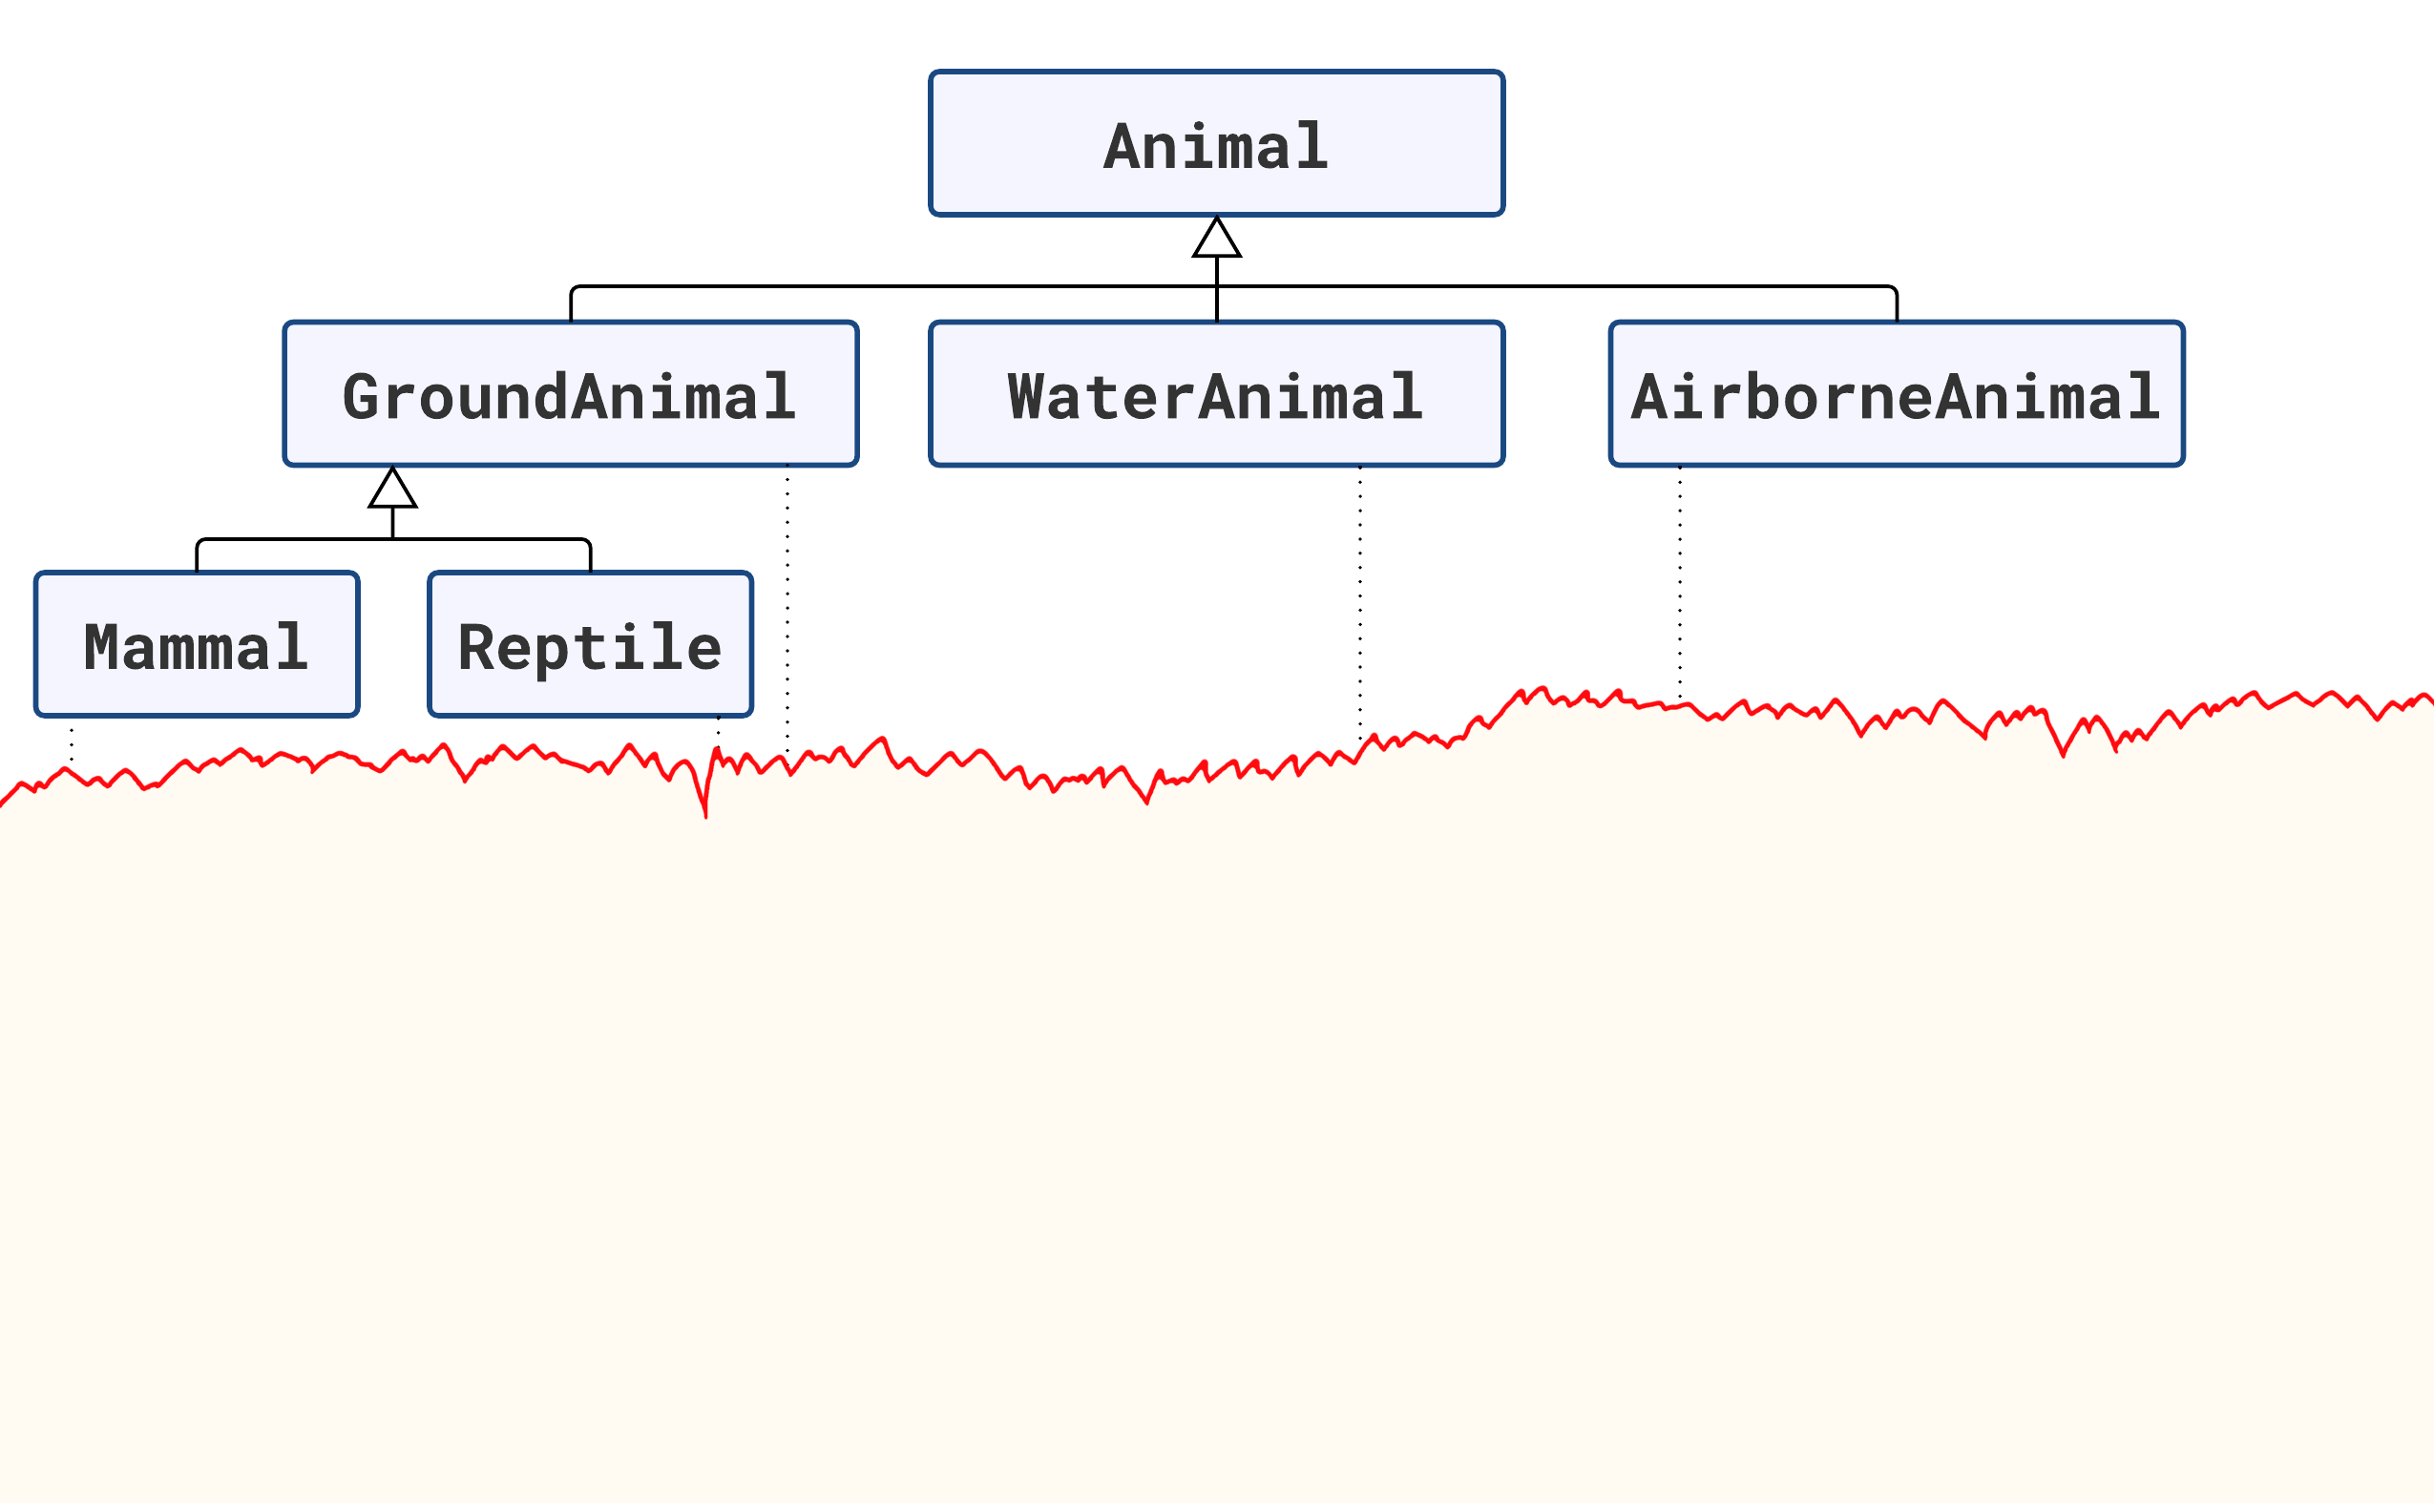

Slide 13
Animal obj = ...

Slide 14
Animal obj = ...
if (obj is Mammal)
{
}

Slide 15
Animal obj = ...
if (obj is Mammal)
{
Mammal mammal = (Mammal)obj; // e.g. a tiger
}

Slide 16
Animal obj = ...
if (obj is Mammal)
{
Mammal mammal = (Mammal)obj; // e.g. a tiger
// Pull mammal’s tail using all your strength
}

Slide 17
Animal obj = ...
if (obj is Mammal)
{
Mammal mammal = (Mammal)obj; // e.g. a tiger
// Pull mammal’s tail using all your strength
// Run as fast as you can
}

Slide 18
Animal obj = ...
if (obj is Mammal)
{
Mammal mammal = (Mammal)obj; // e.g. a tiger
// Pull mammal’s tail using all your strength
// Run as fast as you can
}

Slide 19
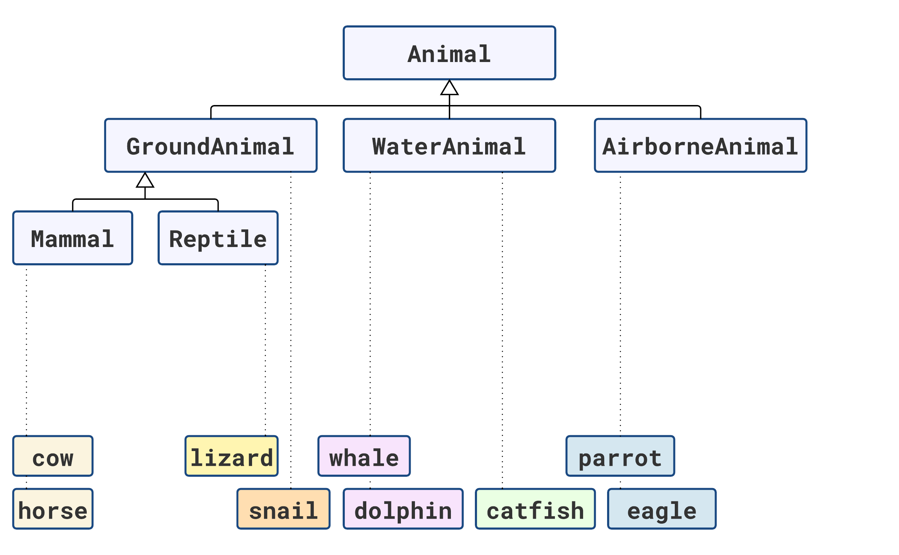

Slide 20
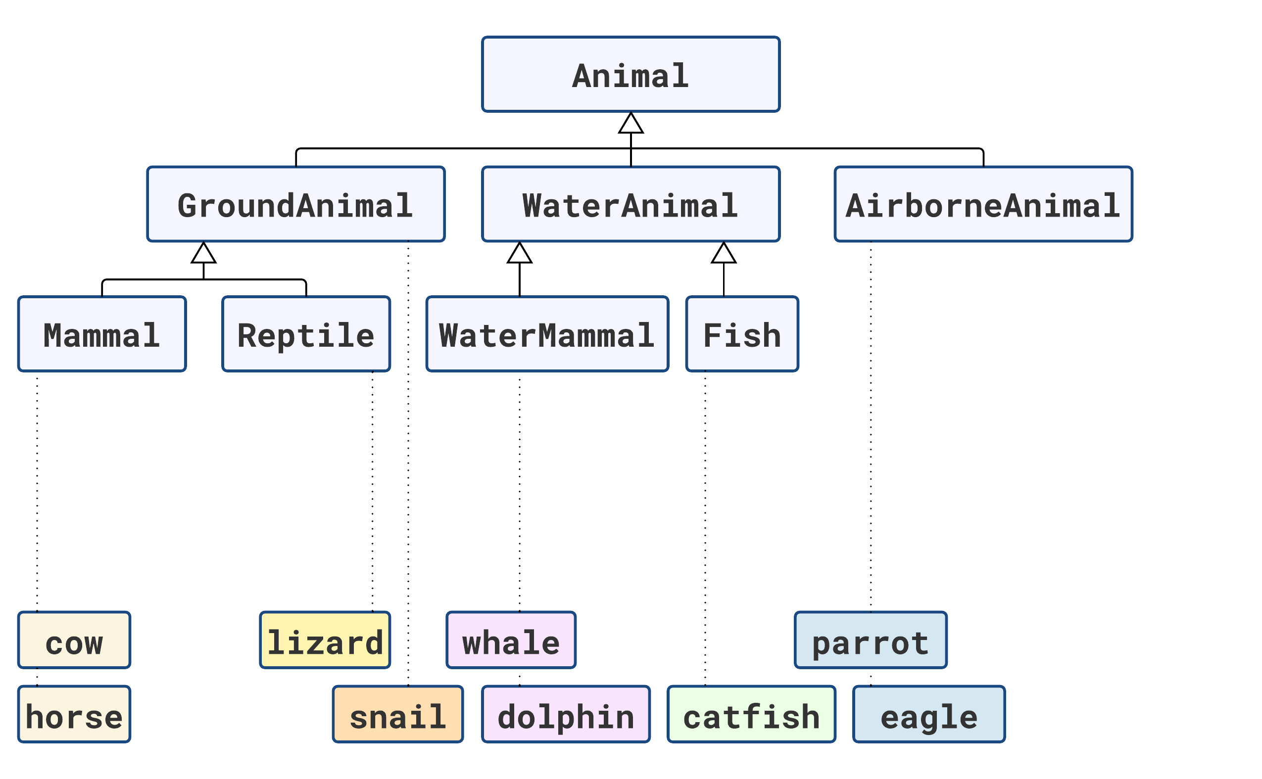

Slide 21
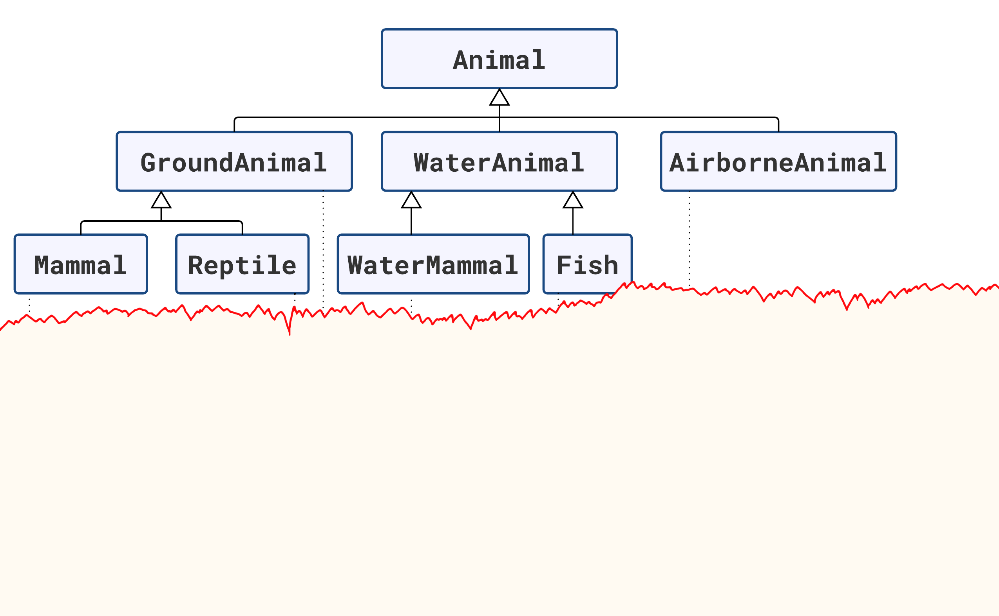
Animal obj = ...
if (obj is Mammal)
{
Mammal mammal = (Mammal)obj; // e.g. a tiger
// Pull mammal’s tail using all your strength
// Run as fast as you can
}

Slide 22
Animal obj = ...
if (obj is Mammal)
{
Mammal mammal = (Mammal)obj; // e.g. a tiger
// Pull mammal’s tail using all your strength
// Run as fast as you can
}
else if (obj is WaterMammal)
{
WaterMammal mammal = (WaterMammal)obj; // e.g. a whale
// Pull mammal’s fins using all your strength
// Swim as fast as you can
}

Slide 23
Animal obj = ...
if (obj is Mammal)
{
Mammal mammal = (Mammal)obj; // e.g. a tiger
// Pull mammal’s tail using all your strength
// Run as fast as you can
}
else if (obj is WaterMammal)
{
WaterMammal mammal = (WaterMammal)obj; // e.g. a whale
// Pull mammal’s fins using all your strength
// Swim as fast as you can
}

Slide 24
Animal obj = ...
if (obj is Mammal)
{
Mammal mammal = (Mammal)obj; // e.g. a tiger
// Pull mammal’s tail using all your strength
// Run as fast as you can
}
else if (obj is WaterMammal)
{
WaterMammal mammal = (WaterMammal)obj; // e.g. a whale
// Pull mammal’s fins using all your strength
// Swim as fast as you can
}
Logic
duplication,
but no true code duplication!
.

Slide 25
Animal obj = ...
if (obj is Mammal)
{
Mammal mammal = (Mammal)obj; // e.g. a tiger
// Pull mammal’s tail using all your strength
// Run as fast as you can
}
else if (obj is WaterMammal)
{
WaterMammal mammal = (WaterMammal)obj; // e.g. a whale
// Pull mammal’s fins using all your strength
// Swim as fast as you can
}
Logic
duplication,
but no true code duplication!
.

Slide 26
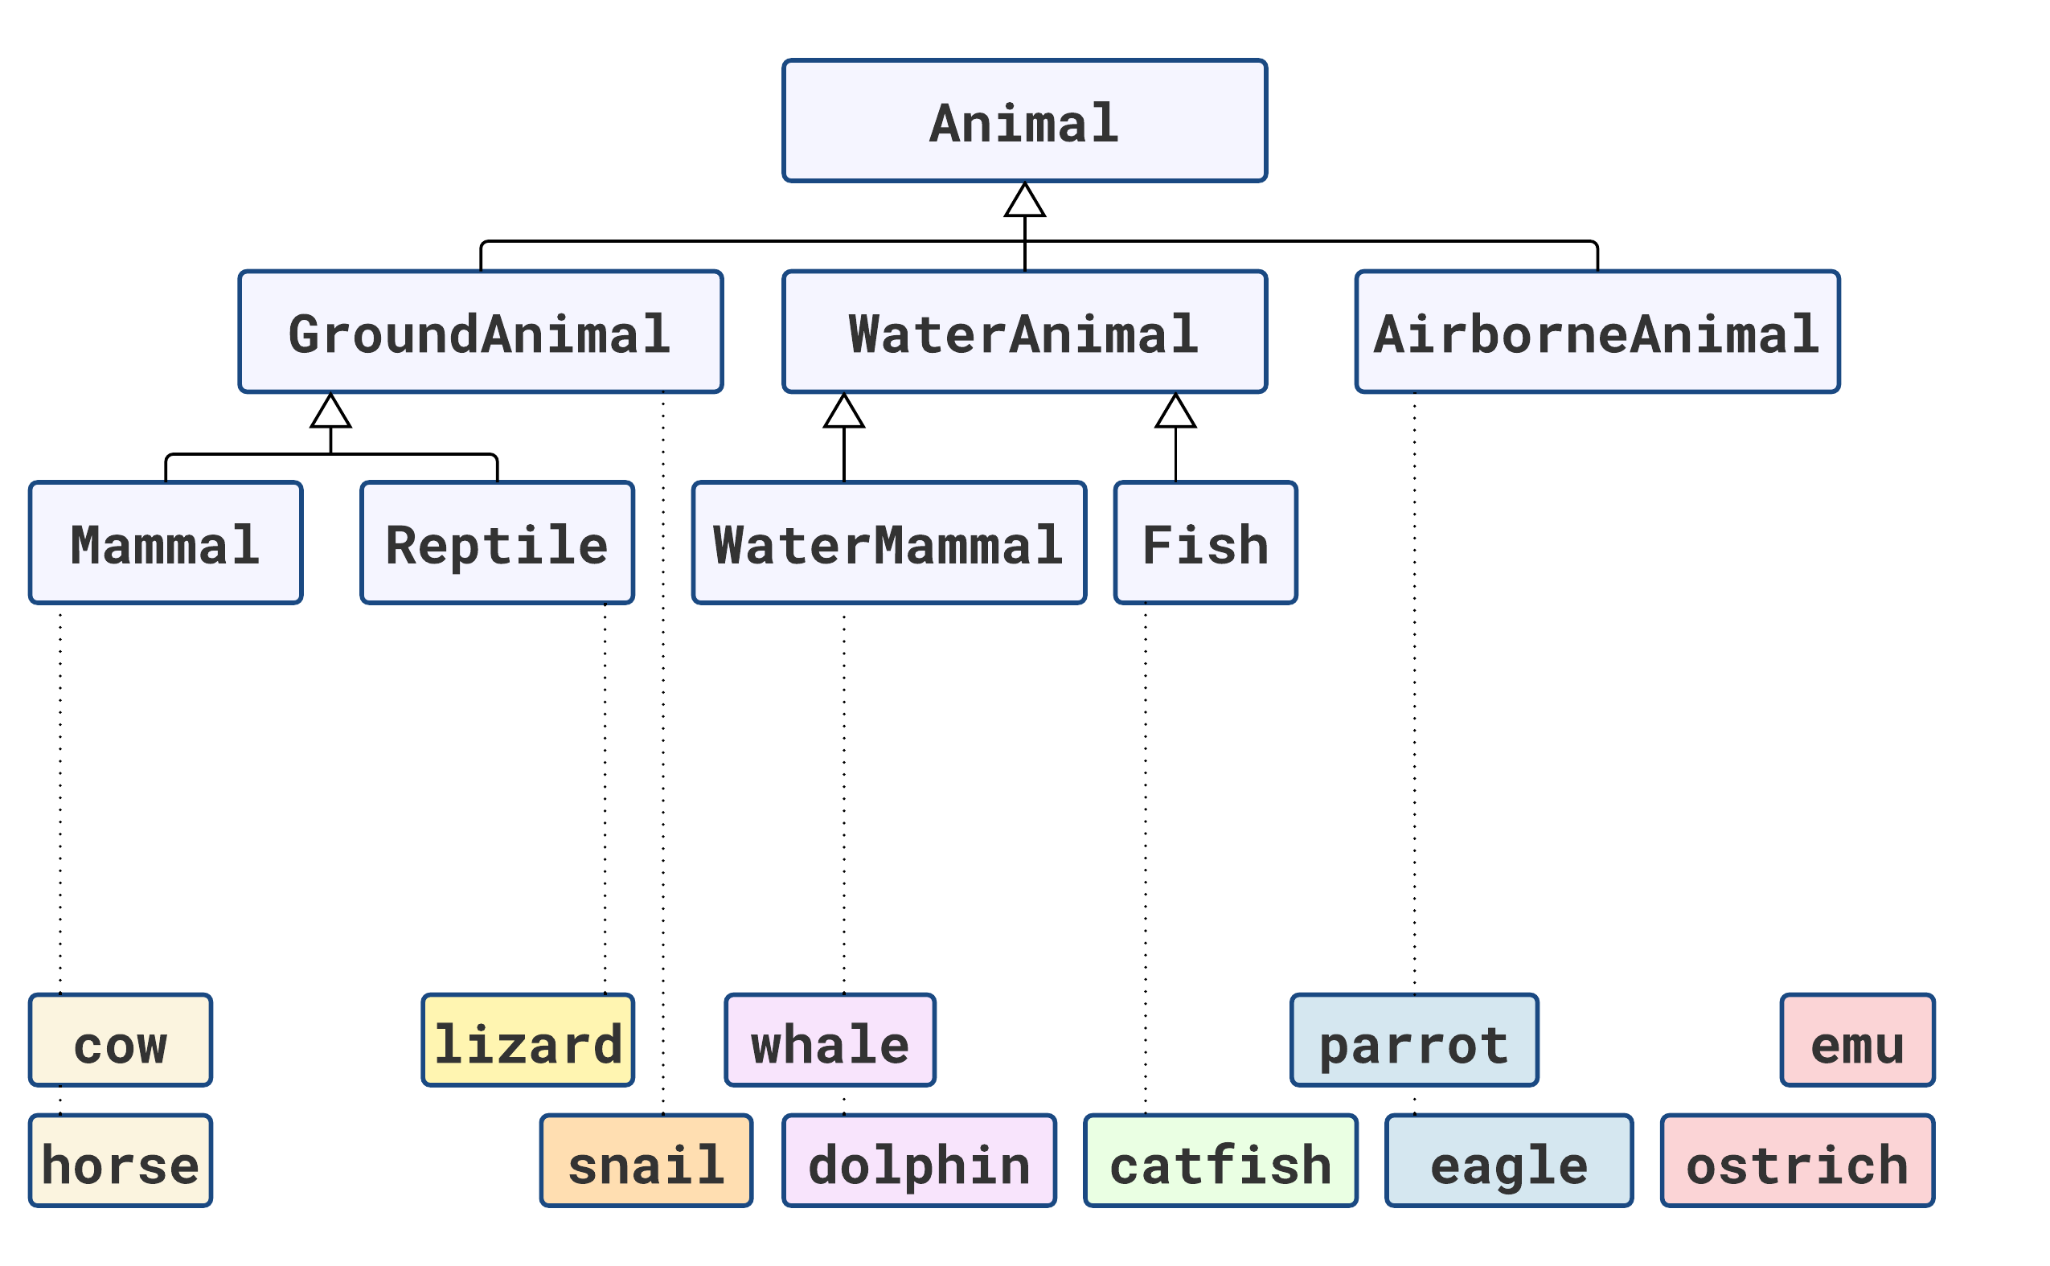

Slide 27
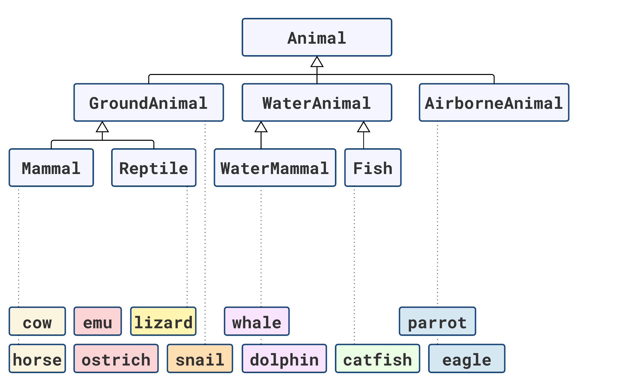

Slide 28
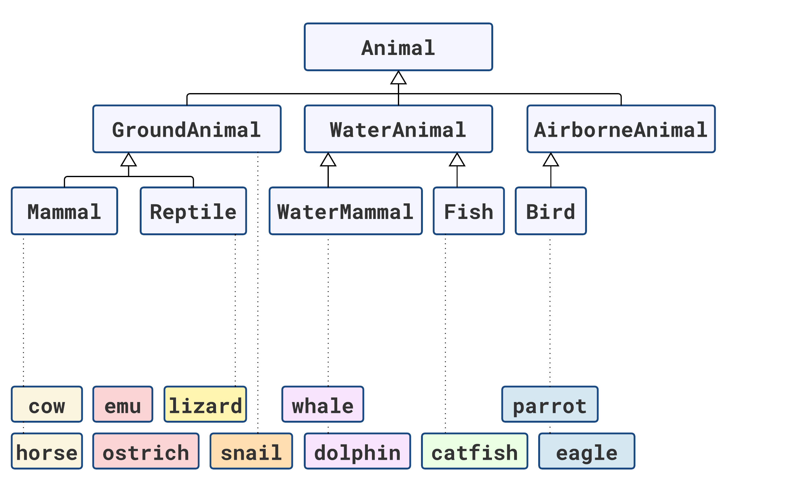

Slide 29
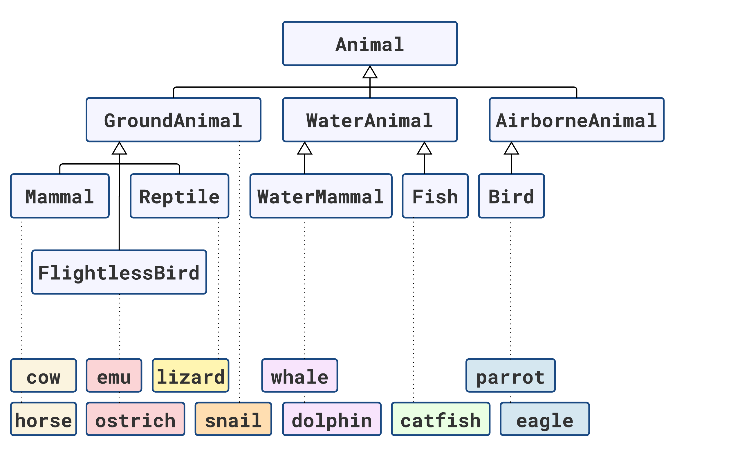

Slide 30
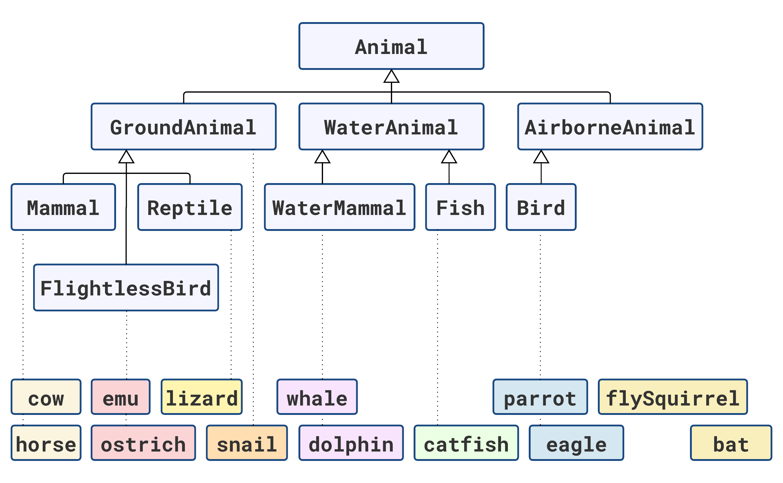

Slide 31
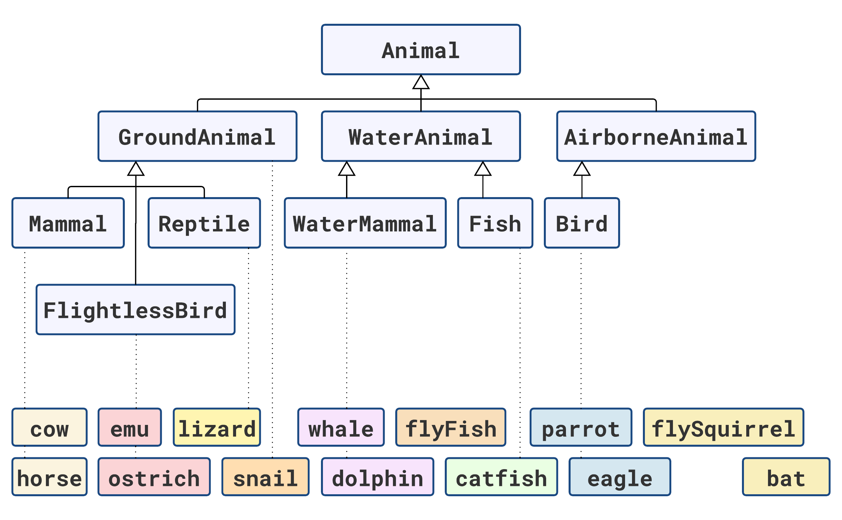

Slide 32
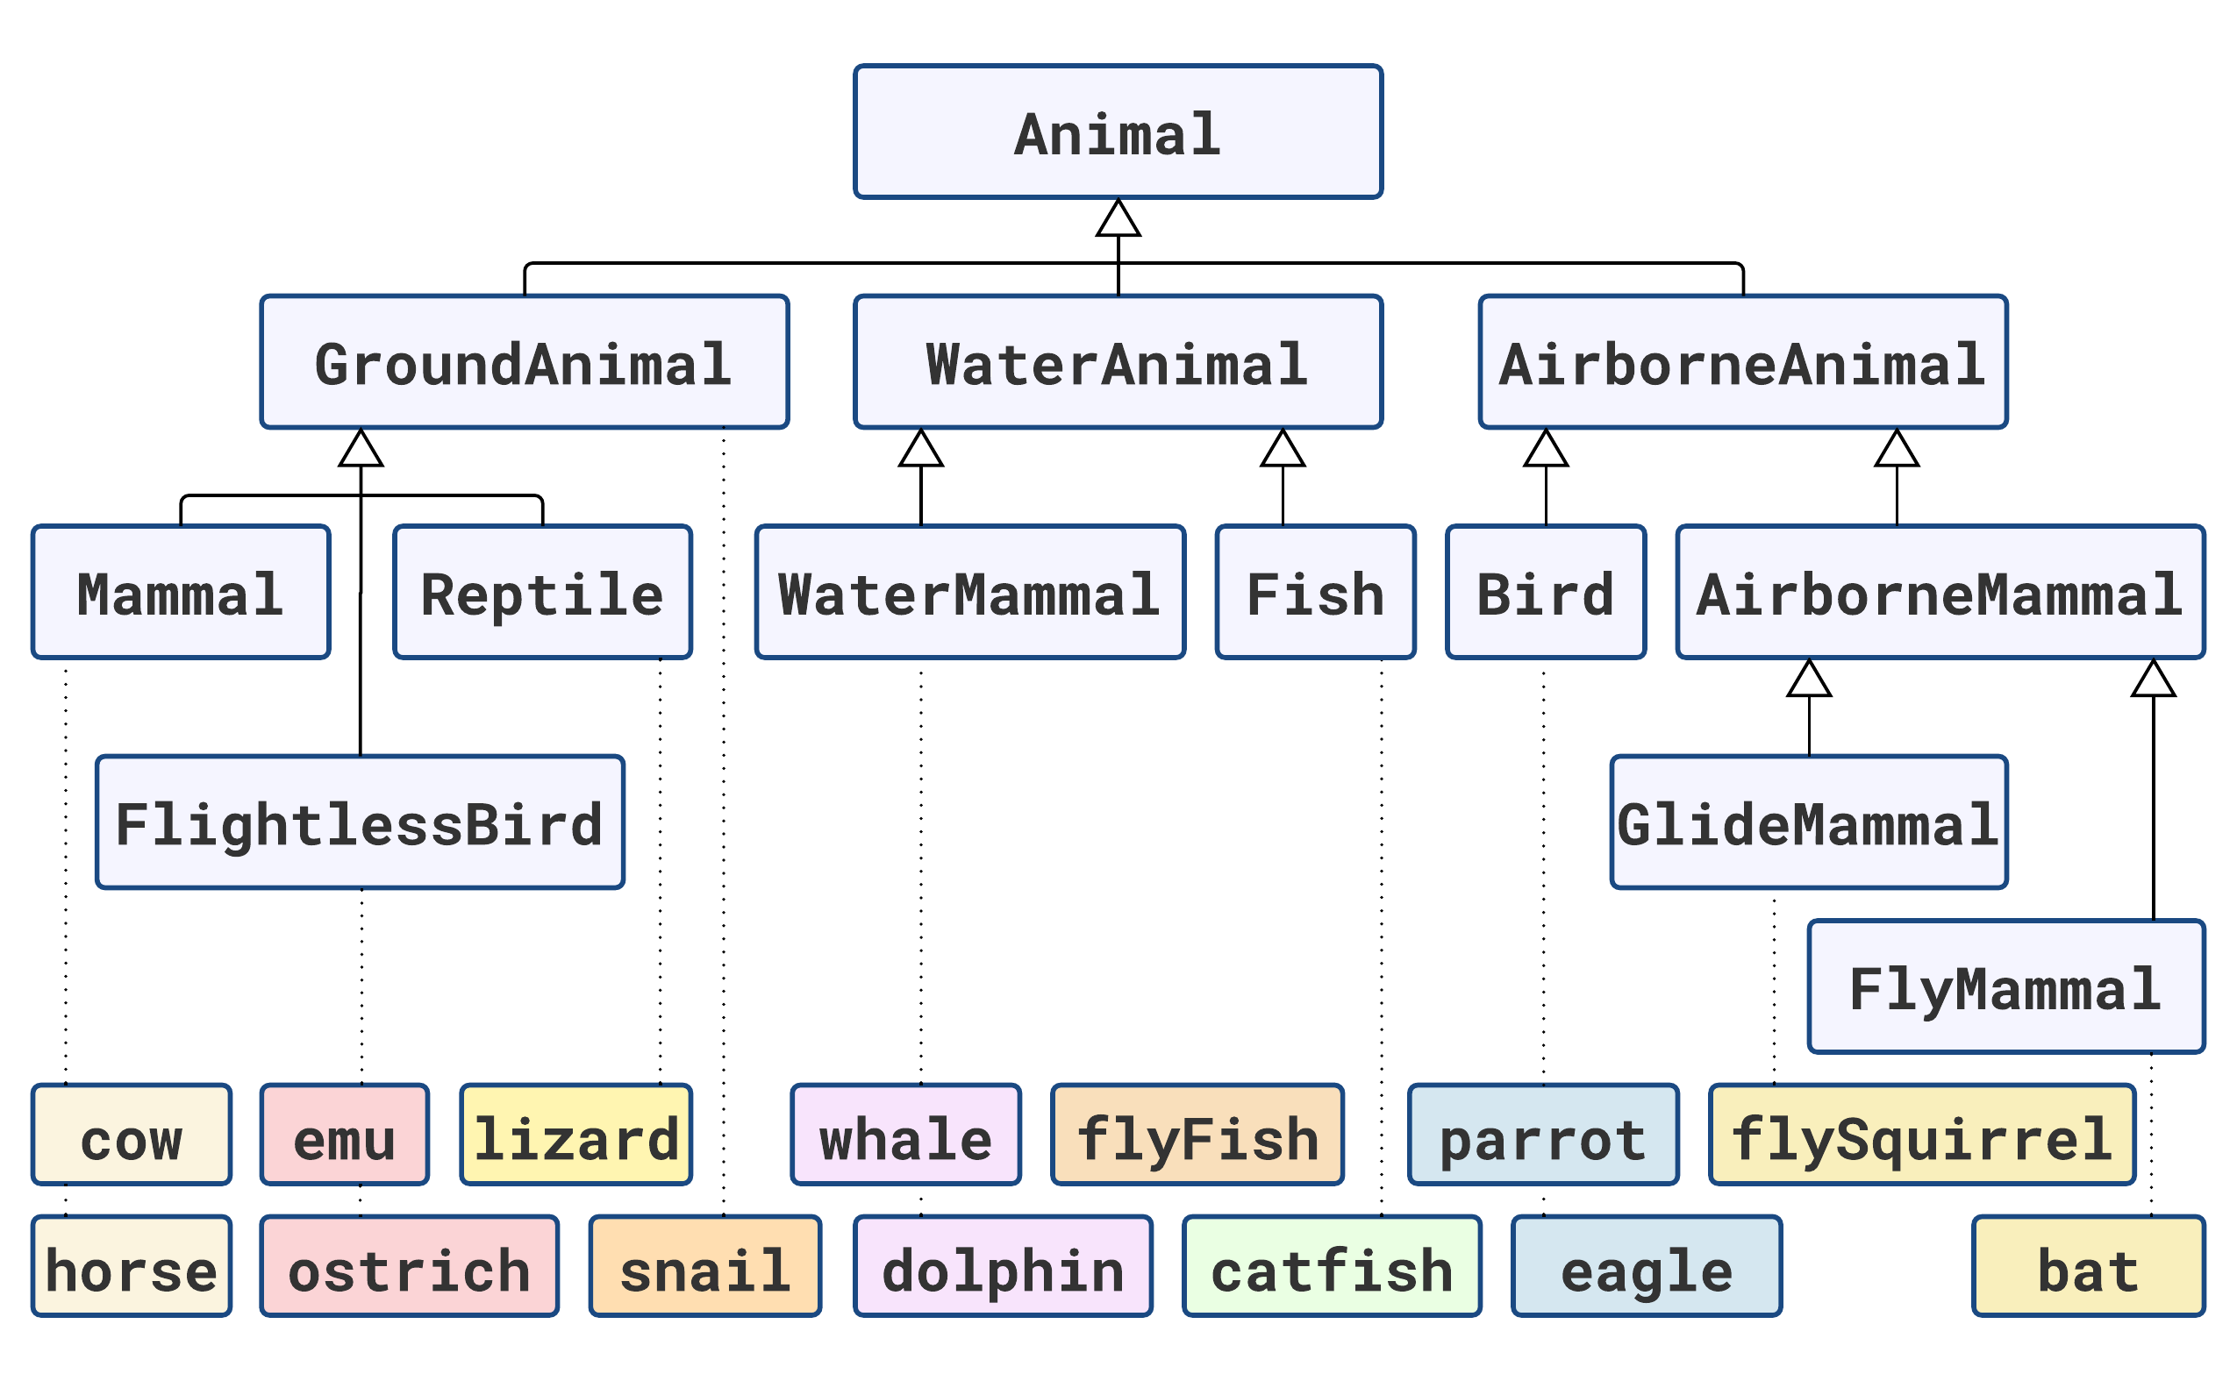

Slide 33
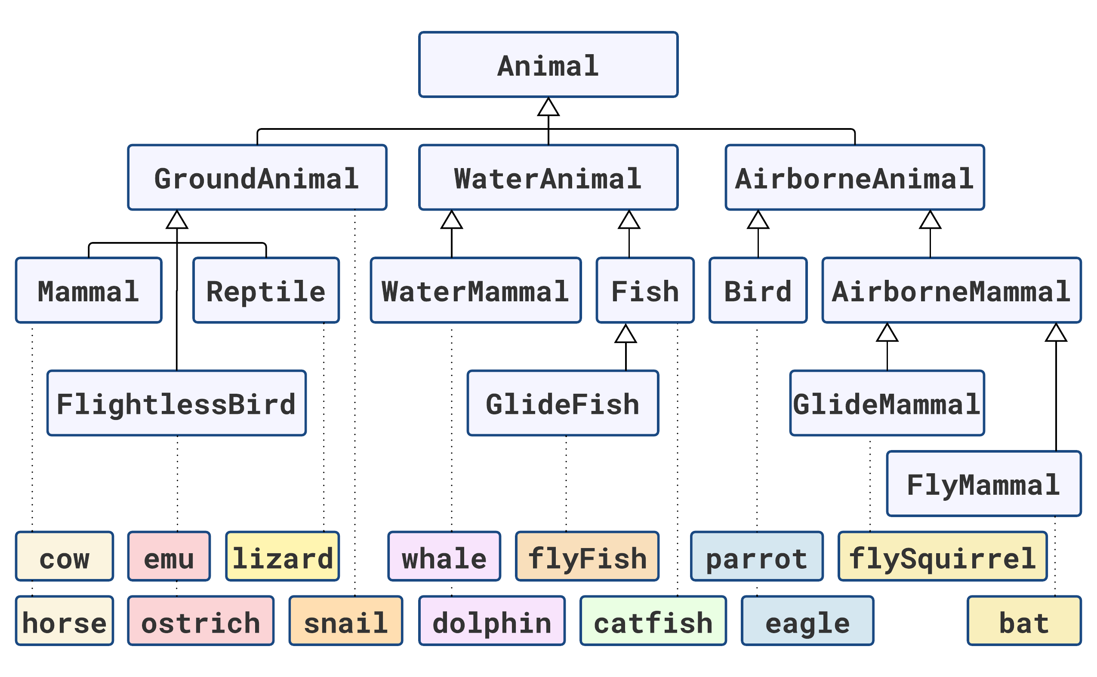

Slide 34
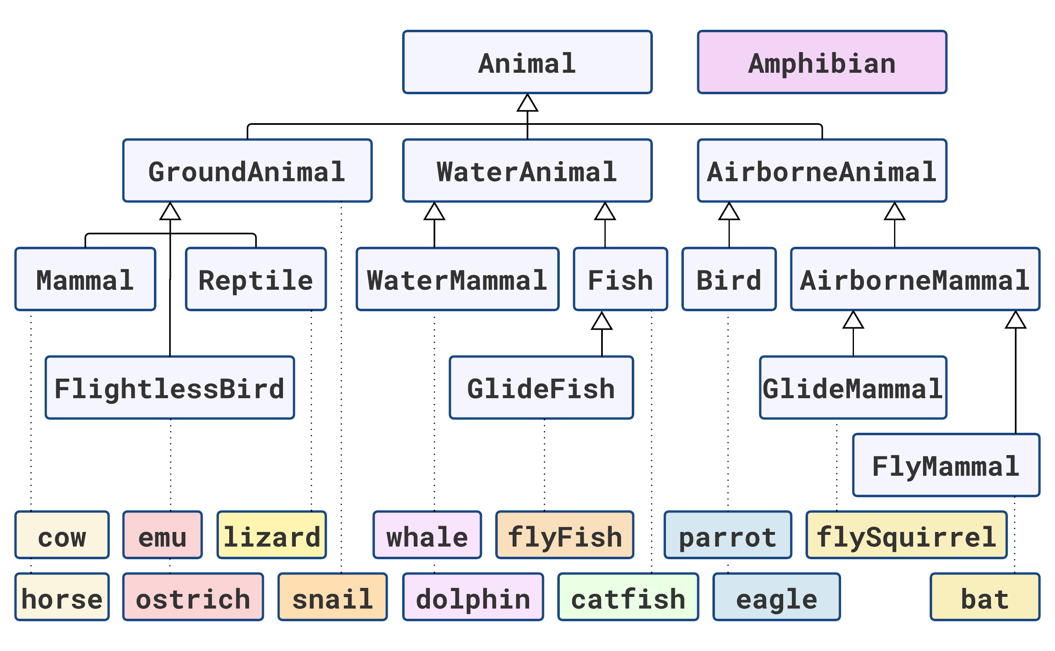

Slide 37


Slide 38
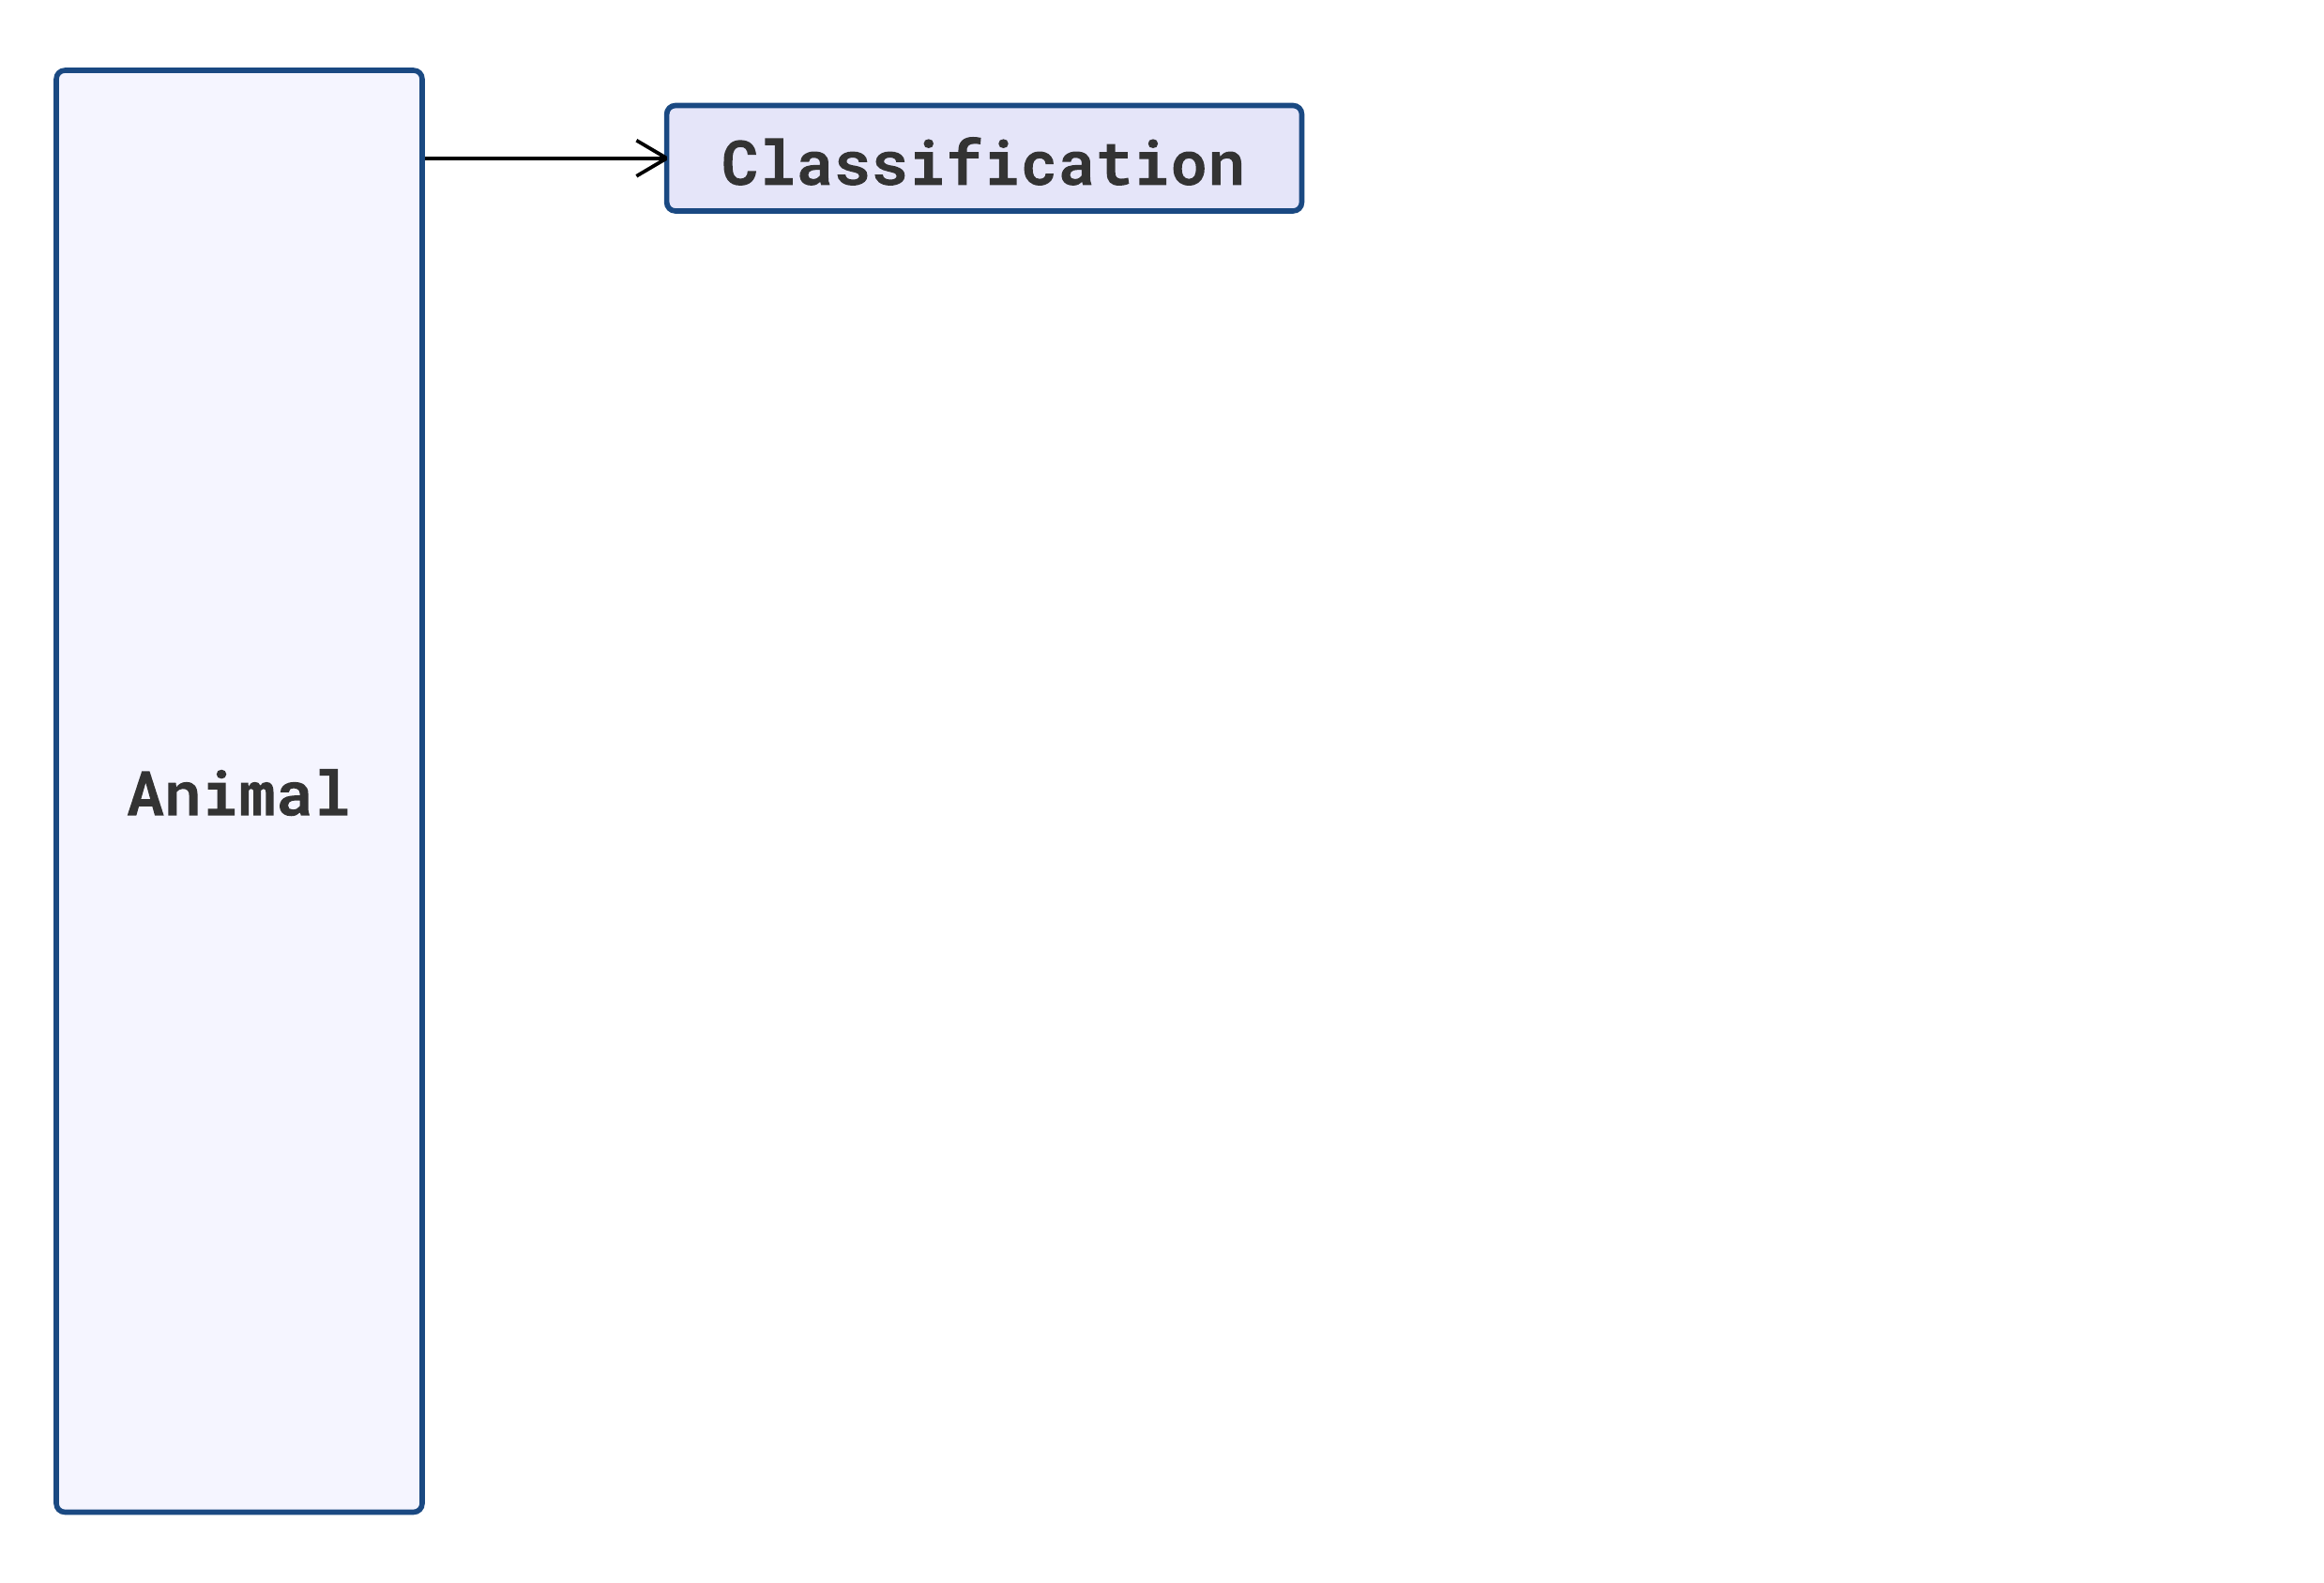

Slide 39
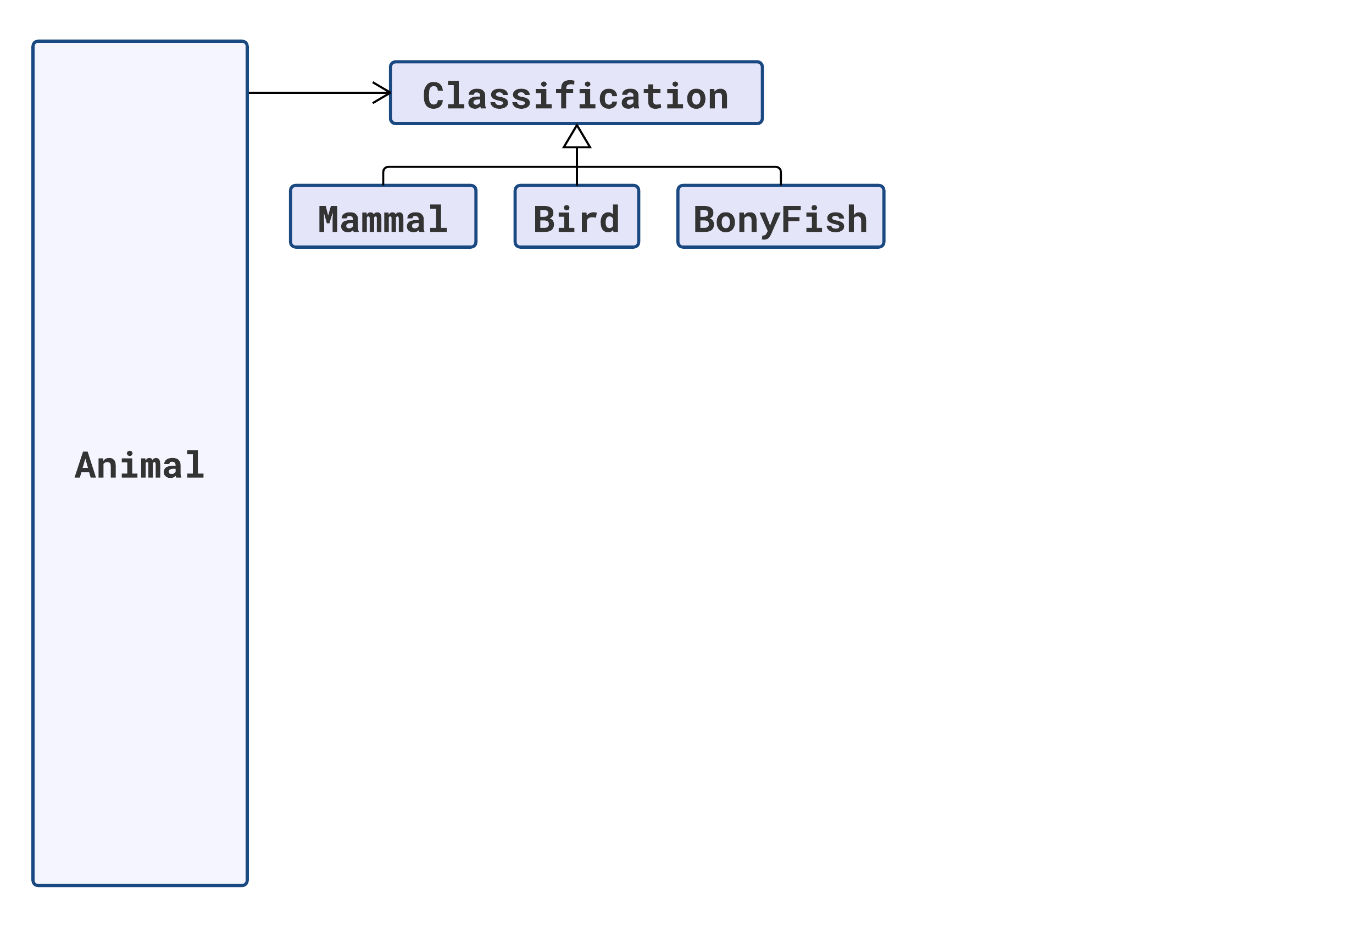

Slide 40
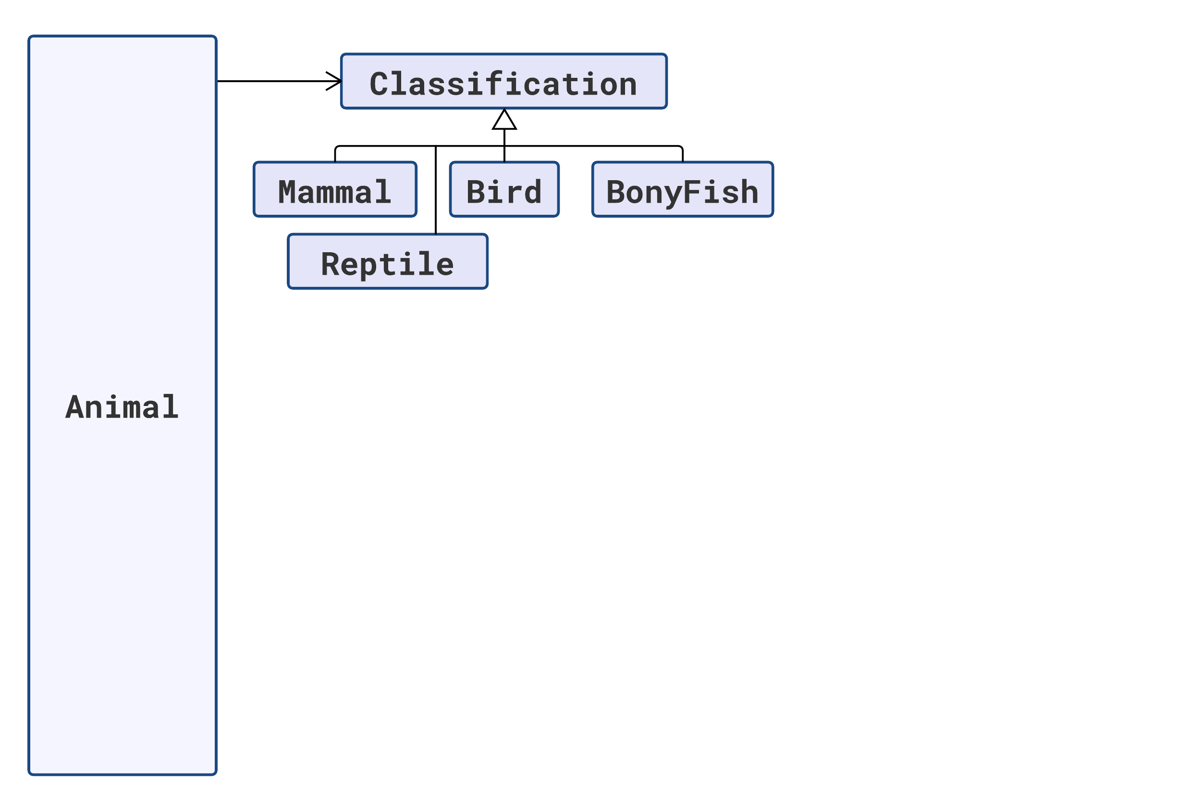

Slide 41
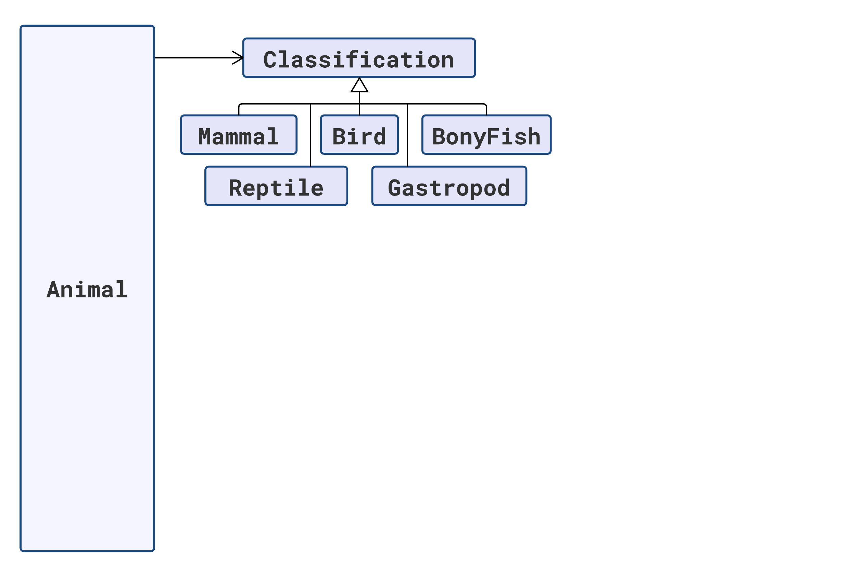

Slide 42
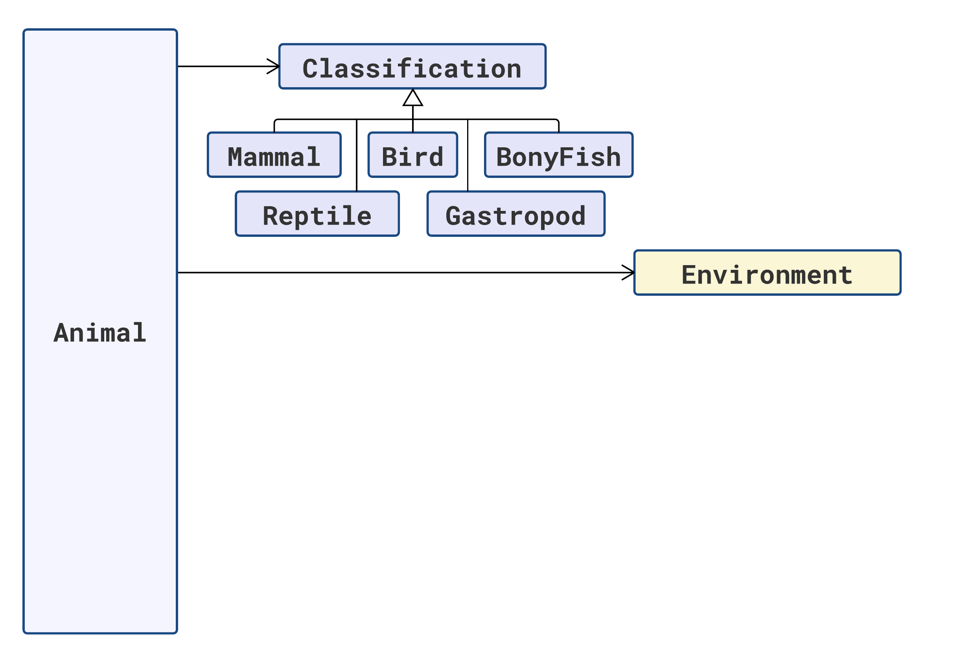

Slide 43
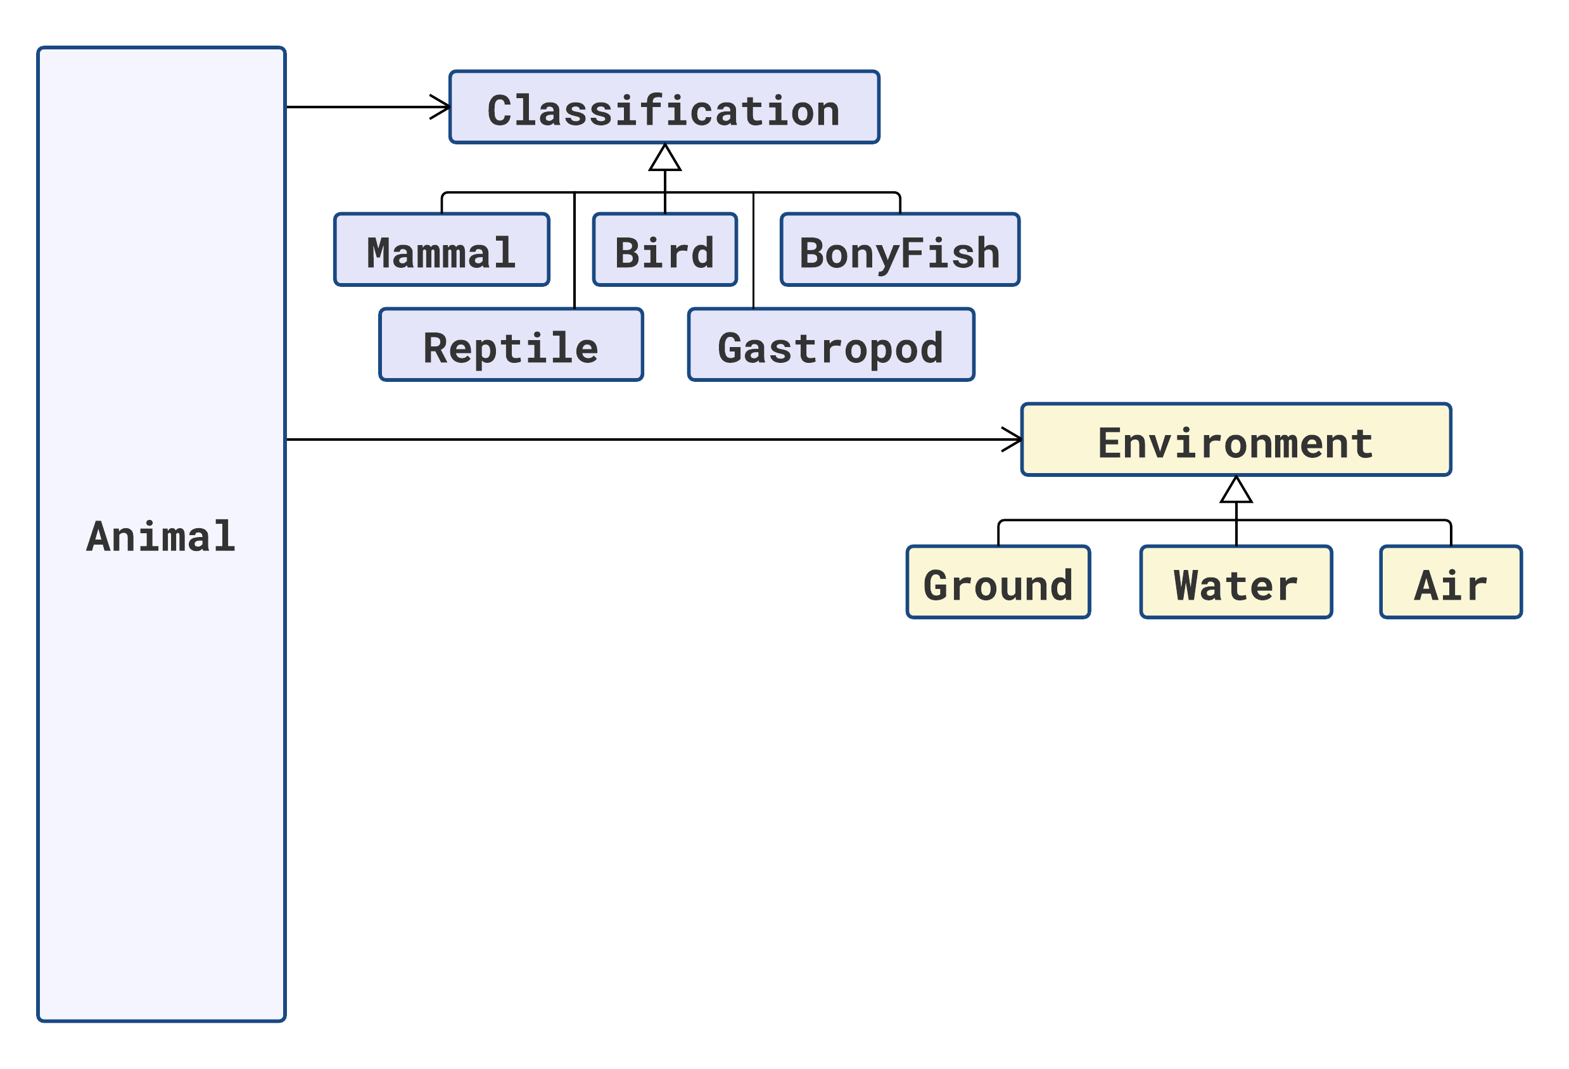

Slide 44
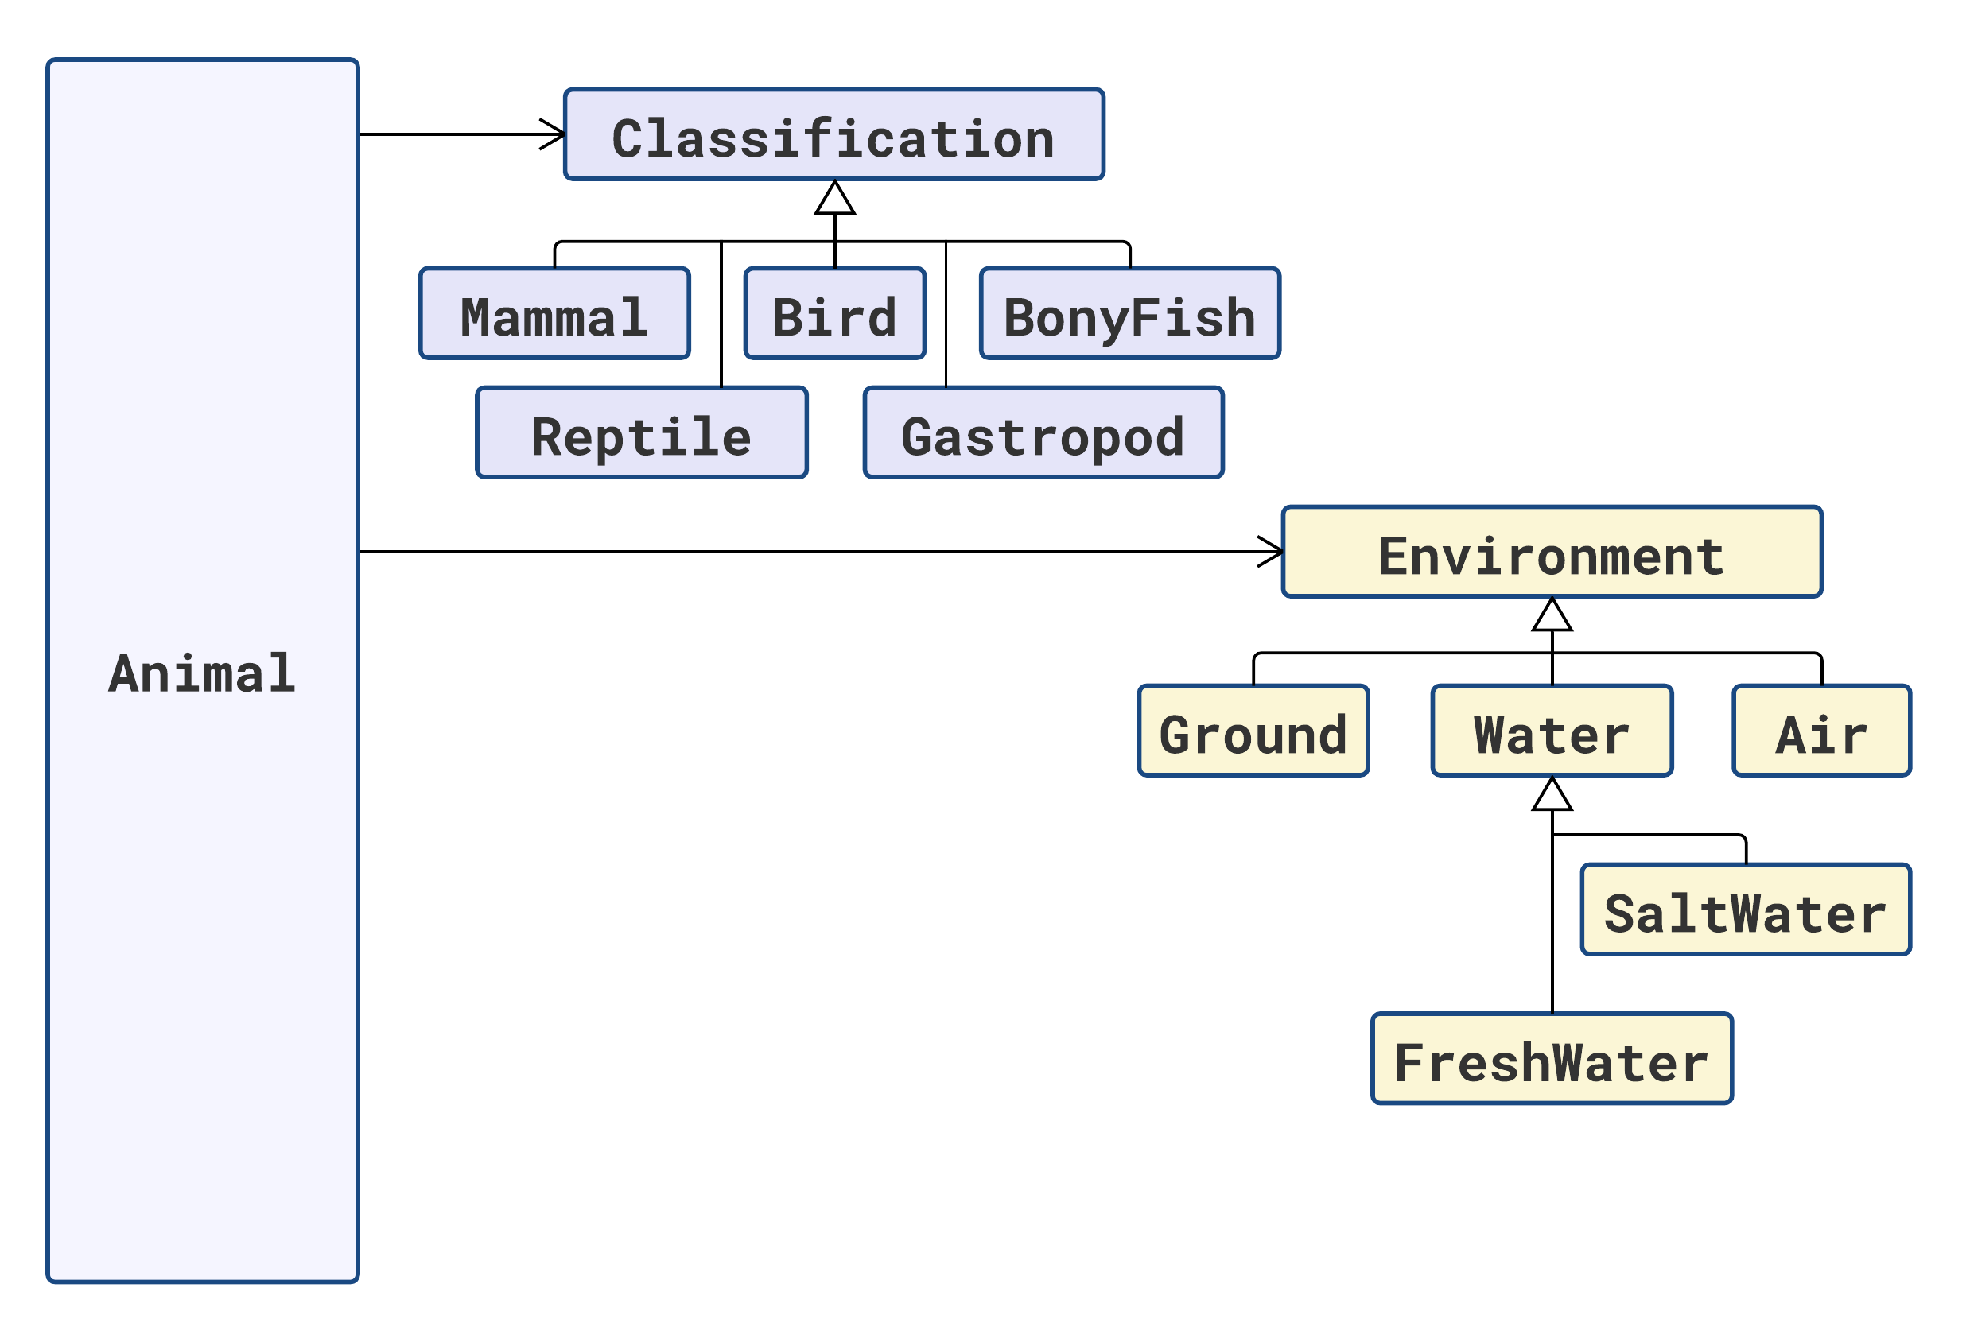

Slide 45
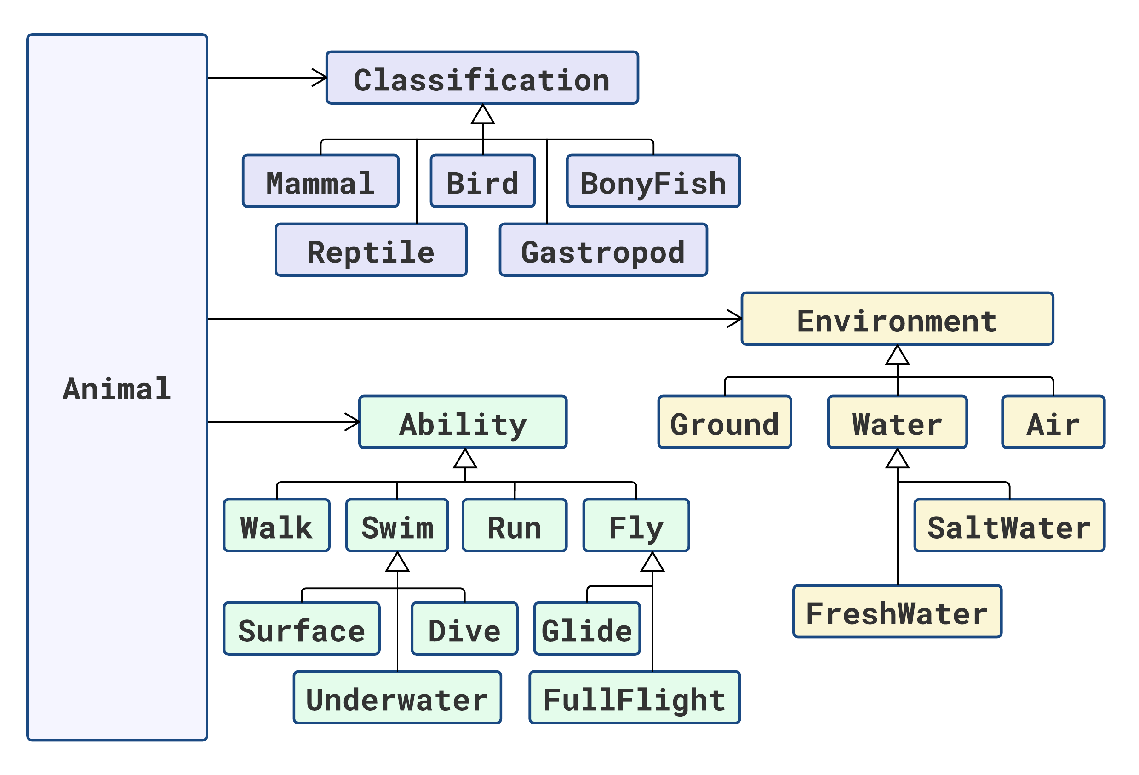

Slide 46









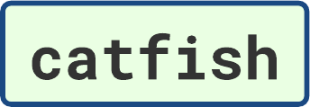



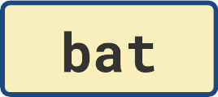
Animal | Classification | Environment | Abilities

Slide 47
Animal | Classification | Environment | Abilities
 | Mammal | Ground | Walk, Run

Slide 48
Animal | Classification | Environment | Abilities
 | Mammal | Ground | Walk, Run
 | Mammal | Ground | Walk, Run

Slide 49
Animal | Classification | Environment | Abilities
 | Mammal | Ground | Walk, Run
 | Mammal | Ground | Walk, Run
 | Bird | Ground | Walk, Run
 | Bird | Ground | Walk, Run

Slide 50
Animal | Classification | Environment | Abilities
 | Mammal | Ground | Walk, Run
 | Mammal | Ground | Walk, Run
 | Bird | Ground | Walk, Run
 | Bird | Ground | Walk, Run
 | Reptile | Ground | Walk

Slide 51
Animal | Classification | Environment | Abilities
 | Mammal | Ground | Walk, Run
 | Mammal | Ground | Walk, Run
 | Bird | Ground | Walk, Run
 | Bird | Ground | Walk, Run
 | Reptile | Ground | Walk
 | Gastropod | Ground | Walk (?)

Slide 52
Animal | Classification | Environment | Abilities
 | Mammal | Ground | Walk, Run
 | Mammal | Ground | Walk, Run
 | Bird | Ground | Walk, Run
 | Bird | Ground | Walk, Run
 | Reptile | Ground | Walk
 | Gastropod | Ground | Walk (?)
 | Mammal | SaltWater | Surface, Dive, Underwater
 | Mammal | SaltWater | Surface, Dive, Underwater

Slide 53
Animal | Classification | Environment | Abilities
 | Mammal | Ground | Walk, Run
 | Mammal | Ground | Walk, Run
 | Bird | Ground | Walk, Run
 | Bird | Ground | Walk, Run
 | Reptile | Ground | Walk
 | Gastropod | Ground | Walk (?)
 | Mammal | SaltWater | Surface, Dive, Underwater
 | Mammal | SaltWater | Surface, Dive, Underwater
 | BonyFish | SaltWater | Underwater, Glide
 | BonyFish | FreshWater | Underwater

Slide 54
Animal | Classification | Environment | Abilities
 | Mammal | Ground | Walk, Run
 | Mammal | Ground | Walk, Run
 | Bird | Ground | Walk, Run
 | Bird | Ground | Walk, Run
 | Reptile | Ground | Walk
 | Gastropod | Ground | Walk (?)
 | Mammal | SaltWater | Surface, Dive, Underwater
 | Mammal | SaltWater | Surface, Dive, Underwater
 | BonyFish | SaltWater | Underwater, Glide
 | BonyFish | FreshWater | Underwater
 | Bird | Air, Ground | Fly, Walk
 | Bird | Air, Ground | Fly

Slide 55
Animal | Classification | Environment | Abilities
 | Mammal | Ground | Walk, Run
 | Mammal | Ground | Walk, Run
 | Bird | Ground | Walk, Run
 | Bird | Ground | Walk, Run
 | Reptile | Ground | Walk
 | Gastropod | Ground | Walk (?)
 | Mammal | SaltWater | Surface, Dive, Underwater
 | Mammal | SaltWater | Surface, Dive, Underwater
 | BonyFish | SaltWater | Underwater, Glide
 | BonyFish | FreshWater | Underwater
 | Bird | Air, Ground | Fly, Walk
 | Bird | Air, Ground | Fly
 | Mammal | Ground | Walk, Run, Glide

Slide 56
Animal | Classification | Environment | Abilities
 | Mammal | Ground | Walk, Run
 | Mammal | Ground | Walk, Run
 | Bird | Ground | Walk, Run
 | Bird | Ground | Walk, Run
 | Reptile | Ground | Walk
 | Gastropod | Ground | Walk (?)
 | Mammal | SaltWater | Surface, Dive, Underwater
 | Mammal | SaltWater | Surface, Dive, Underwater
 | BonyFish | SaltWater | Underwater, Glide
 | BonyFish | FreshWater | Underwater
 | Bird | Air, Ground | Fly, Walk
 | Bird | Air, Ground | Fly
 | Mammal | Ground | Walk, Run, Glide
 | Mammal | Air, Ground | Fly

Slide 57
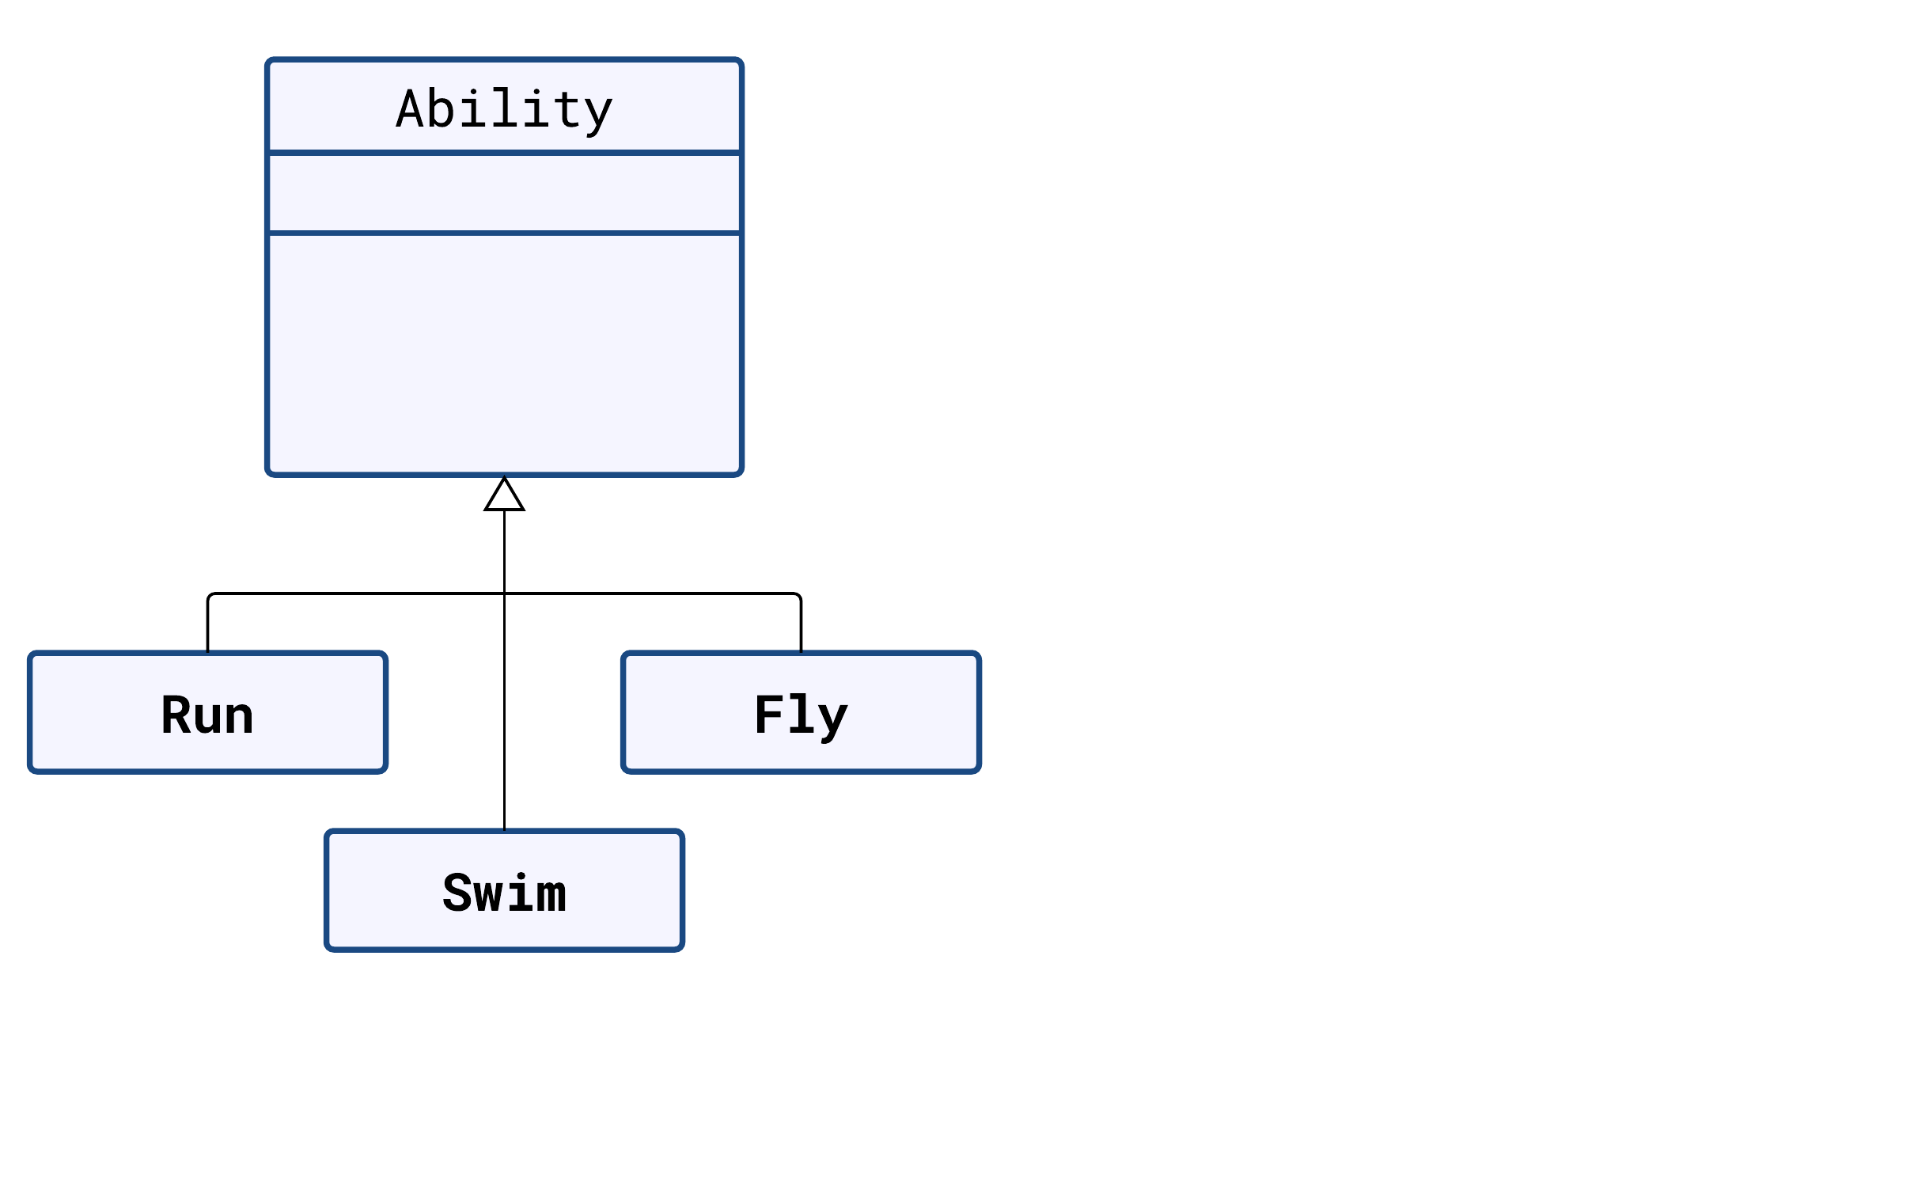

Slide 58
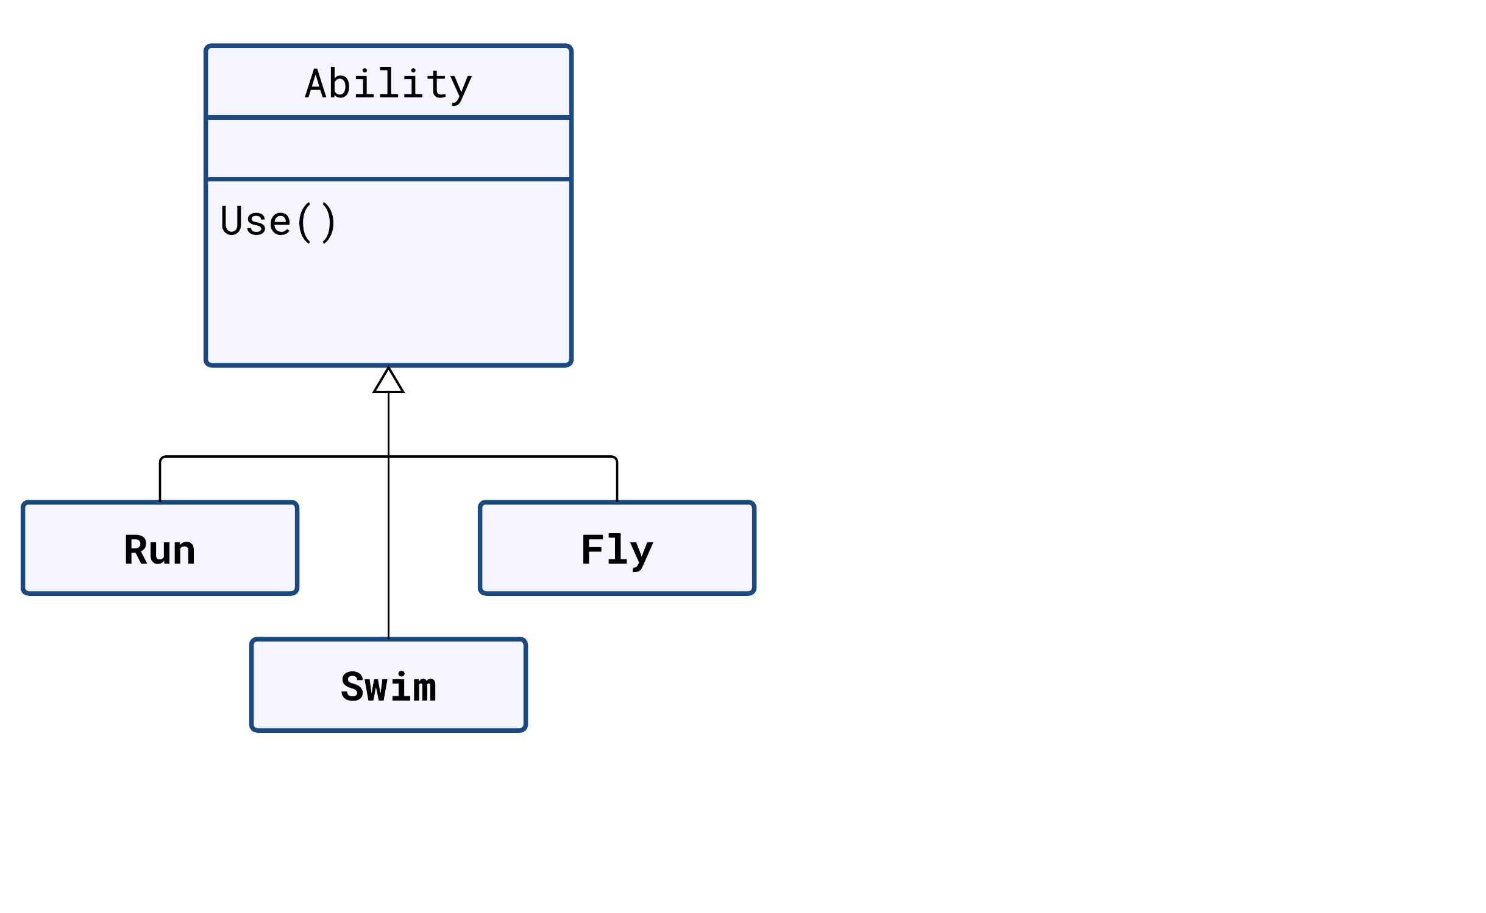

Slide 59
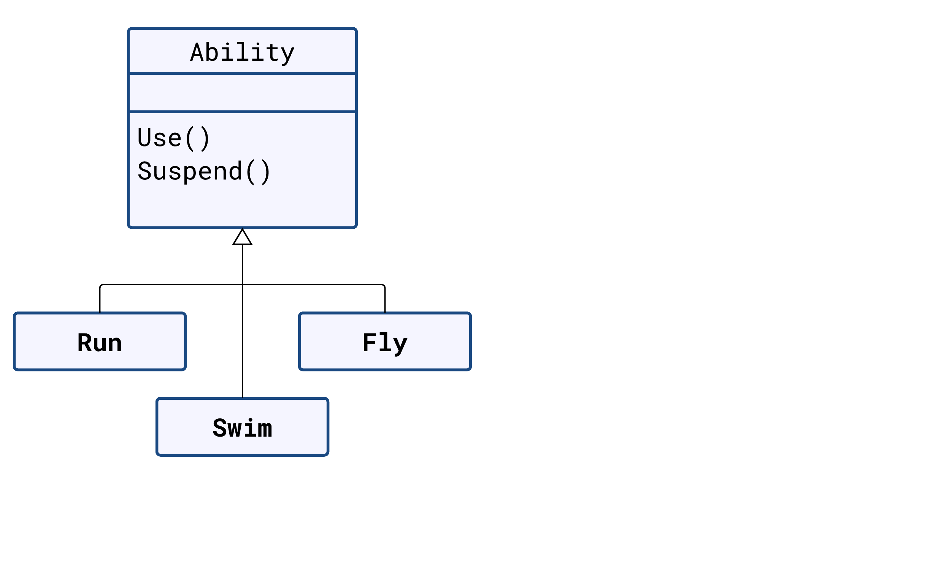

Slide 60
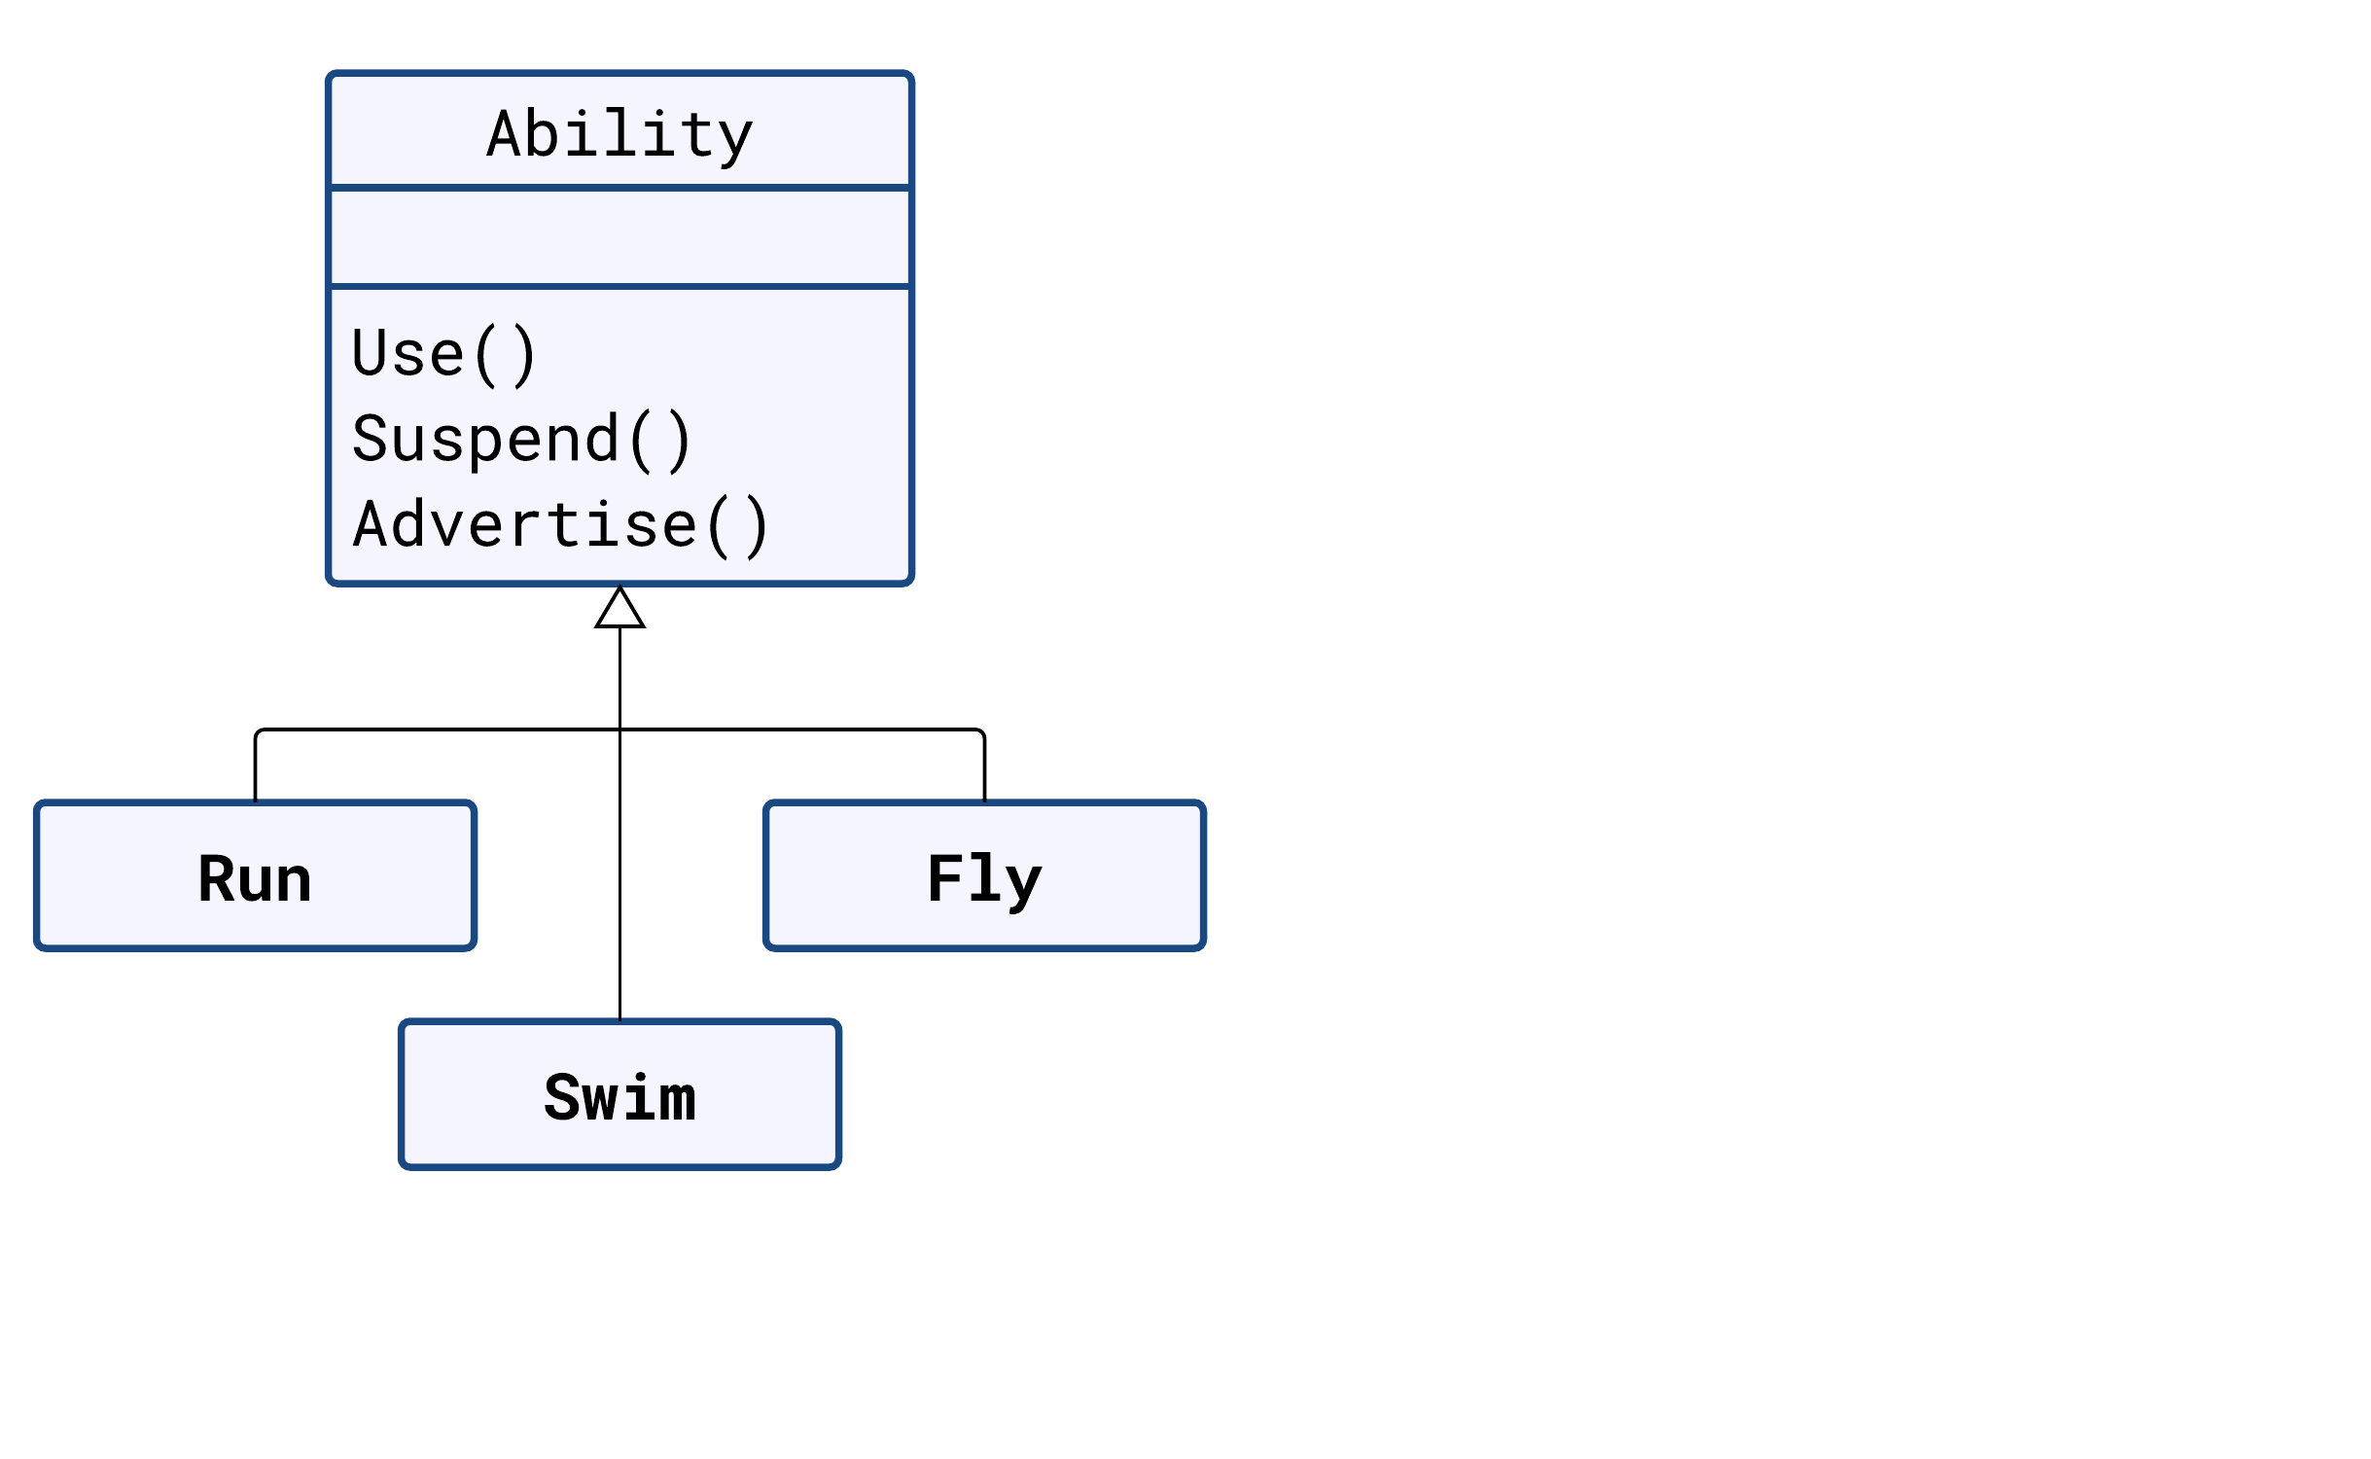

Slide 61
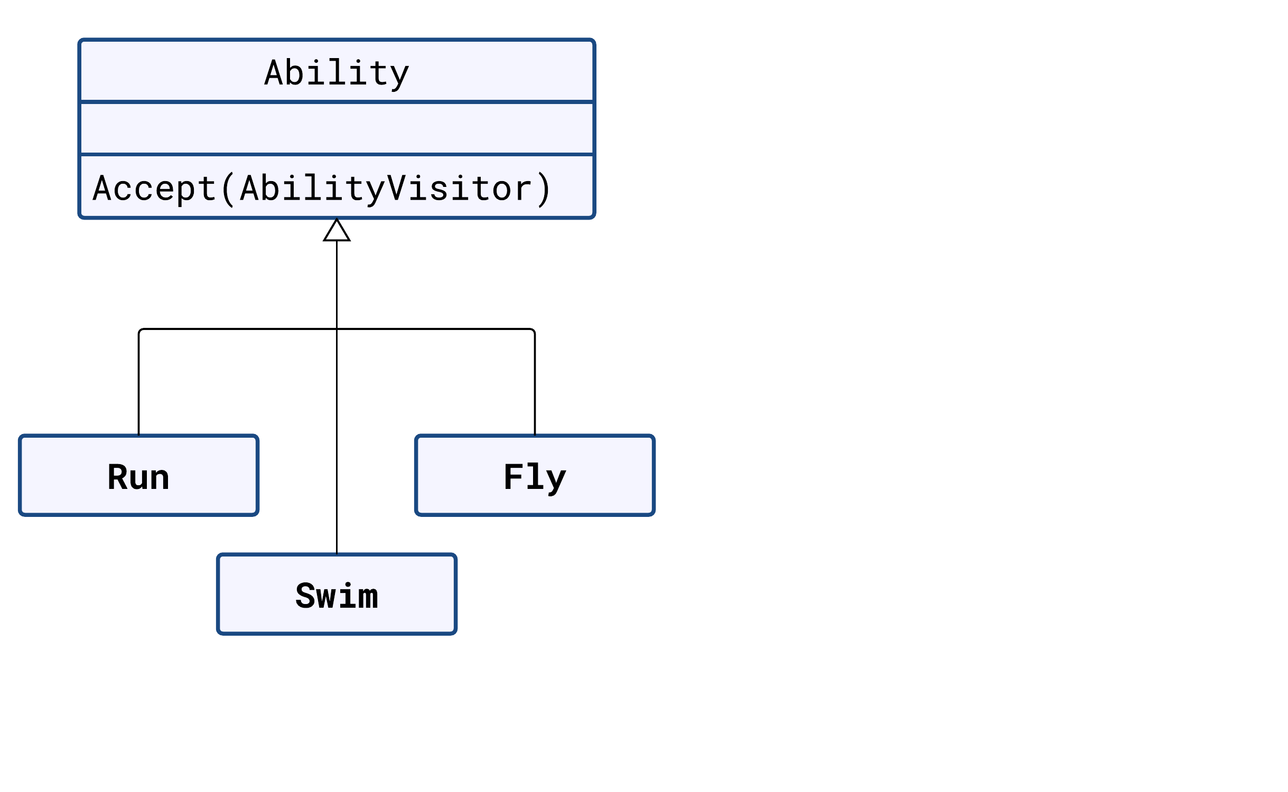

Slide 62
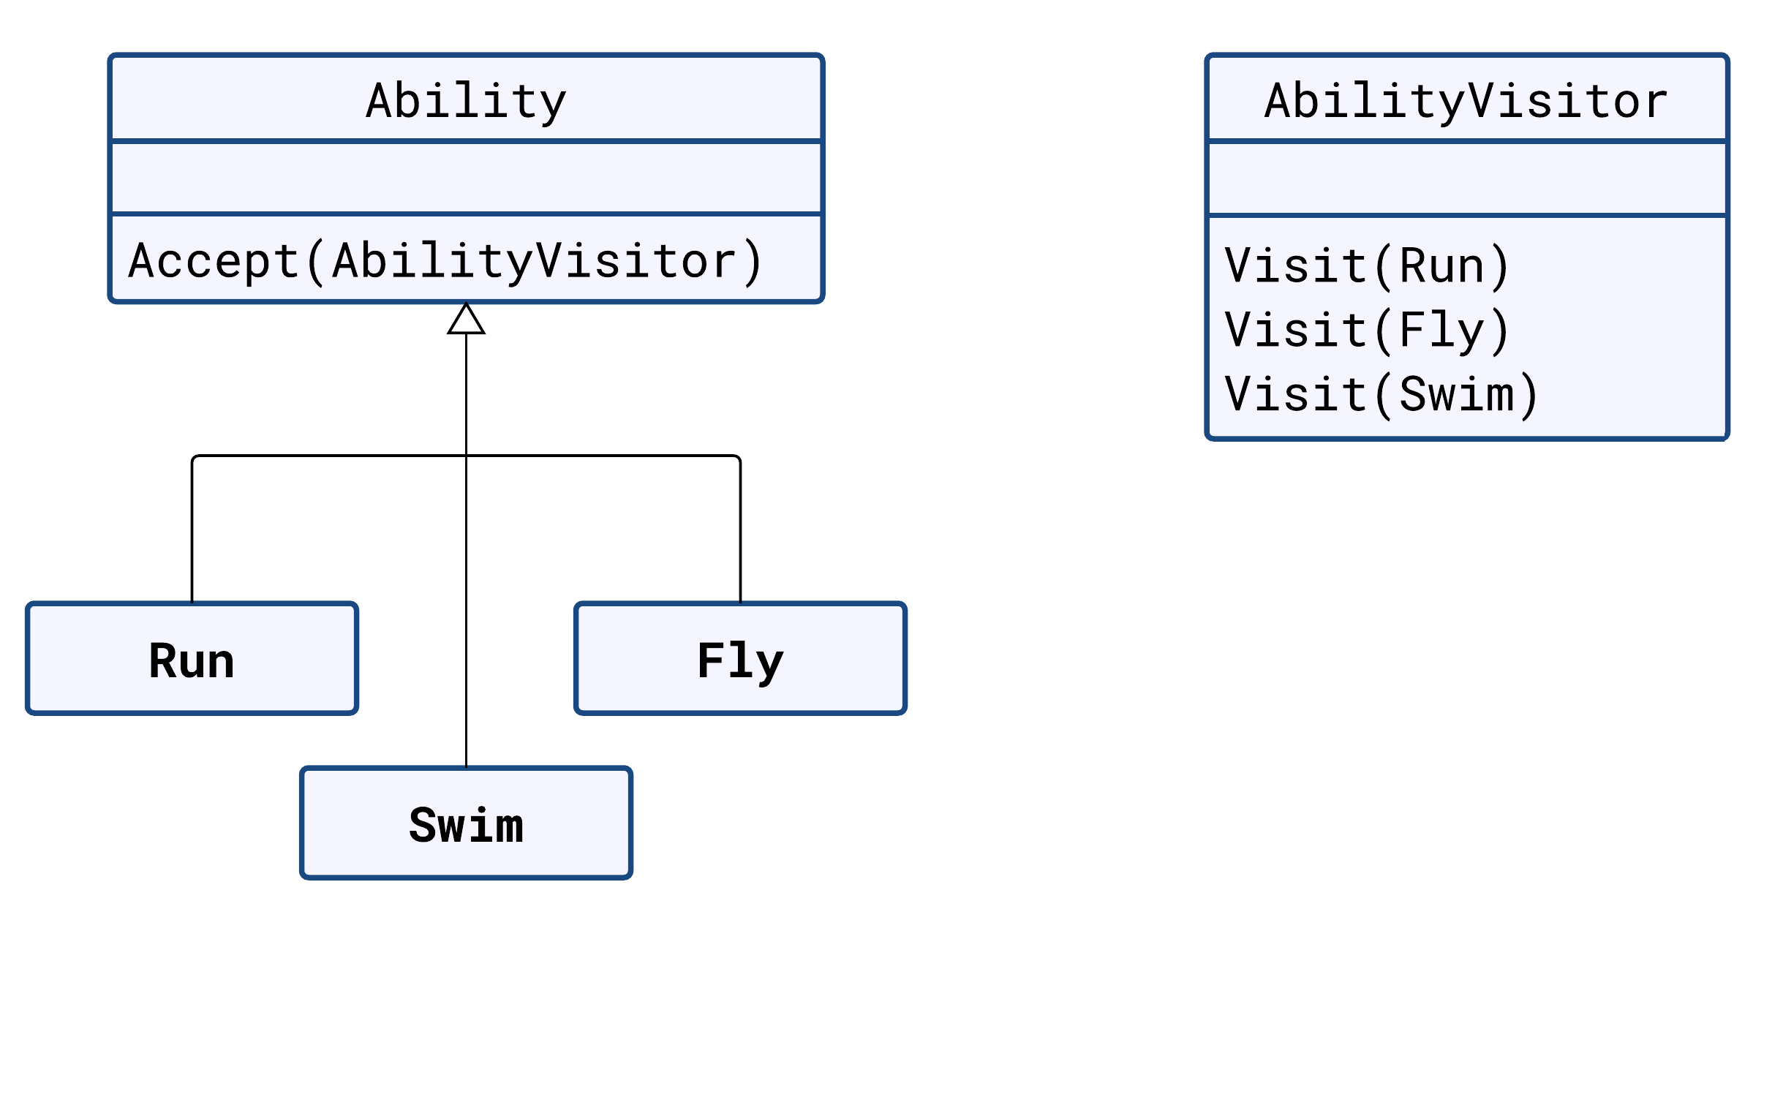

Slide 63
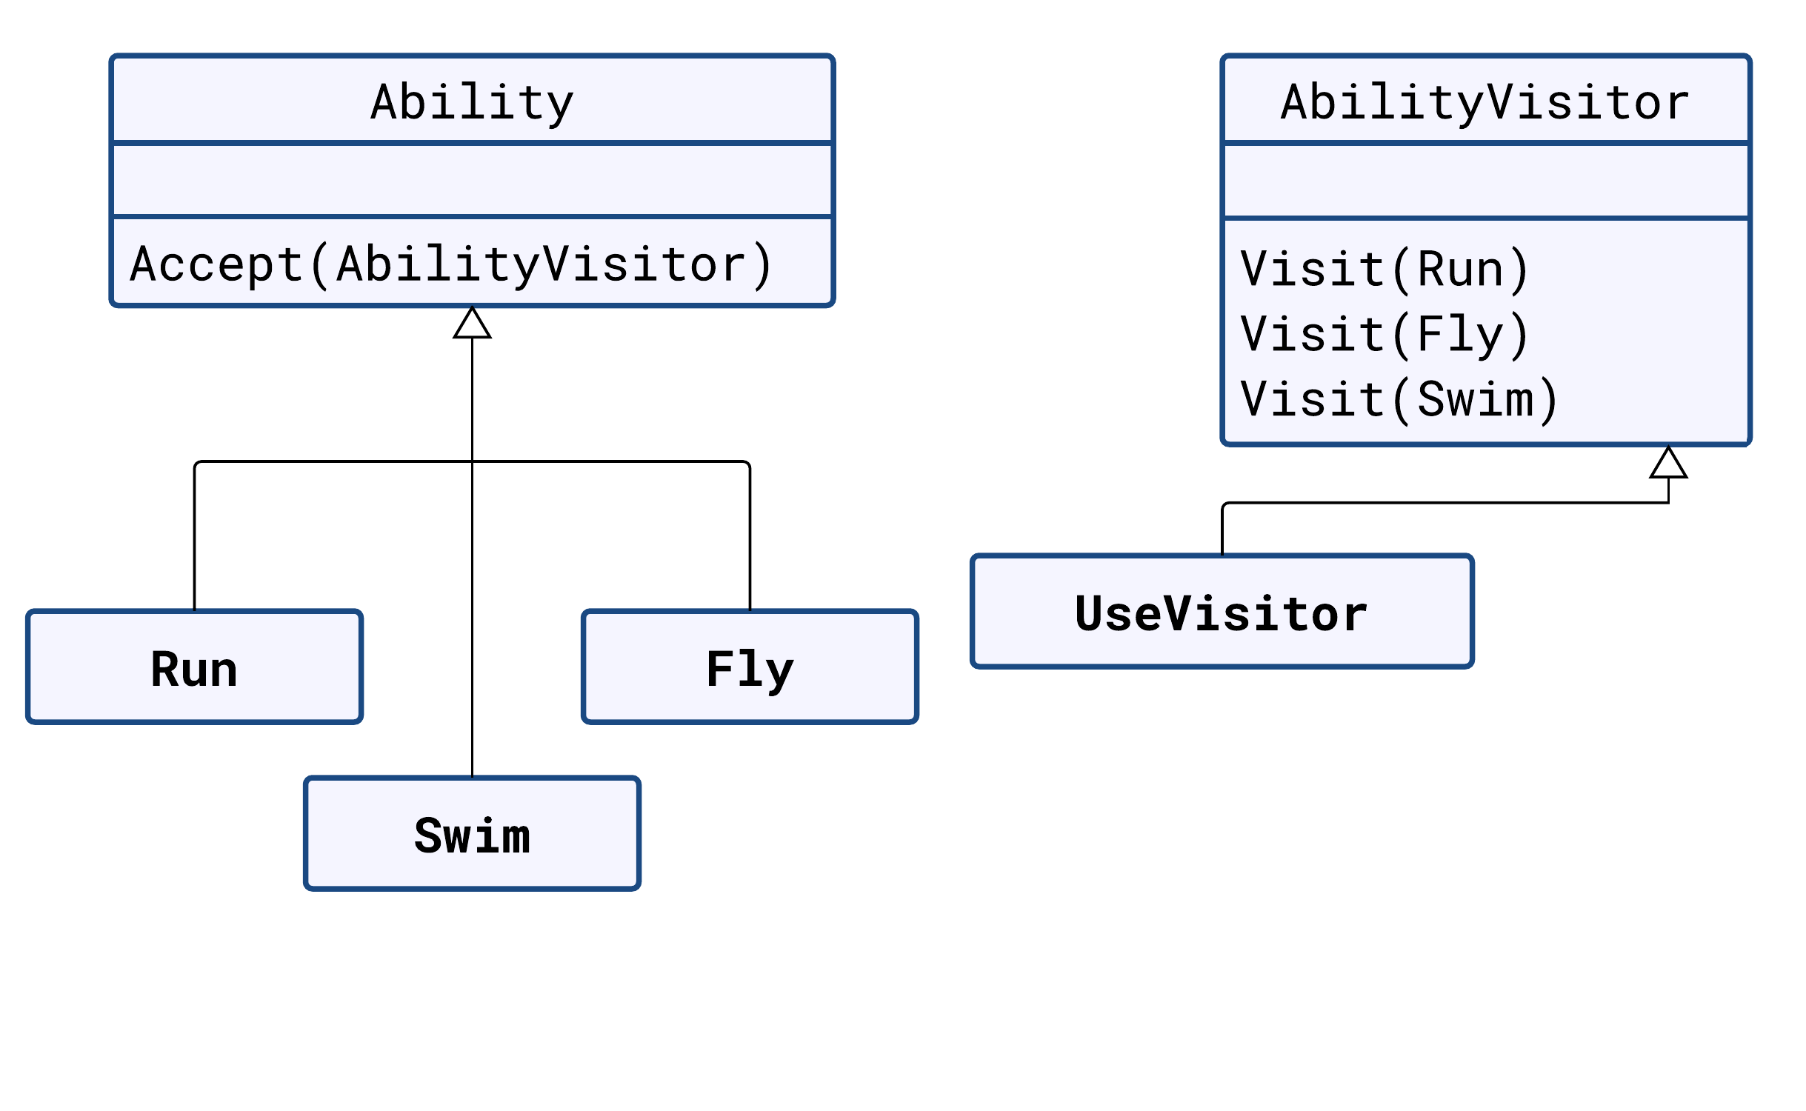

Slide 64
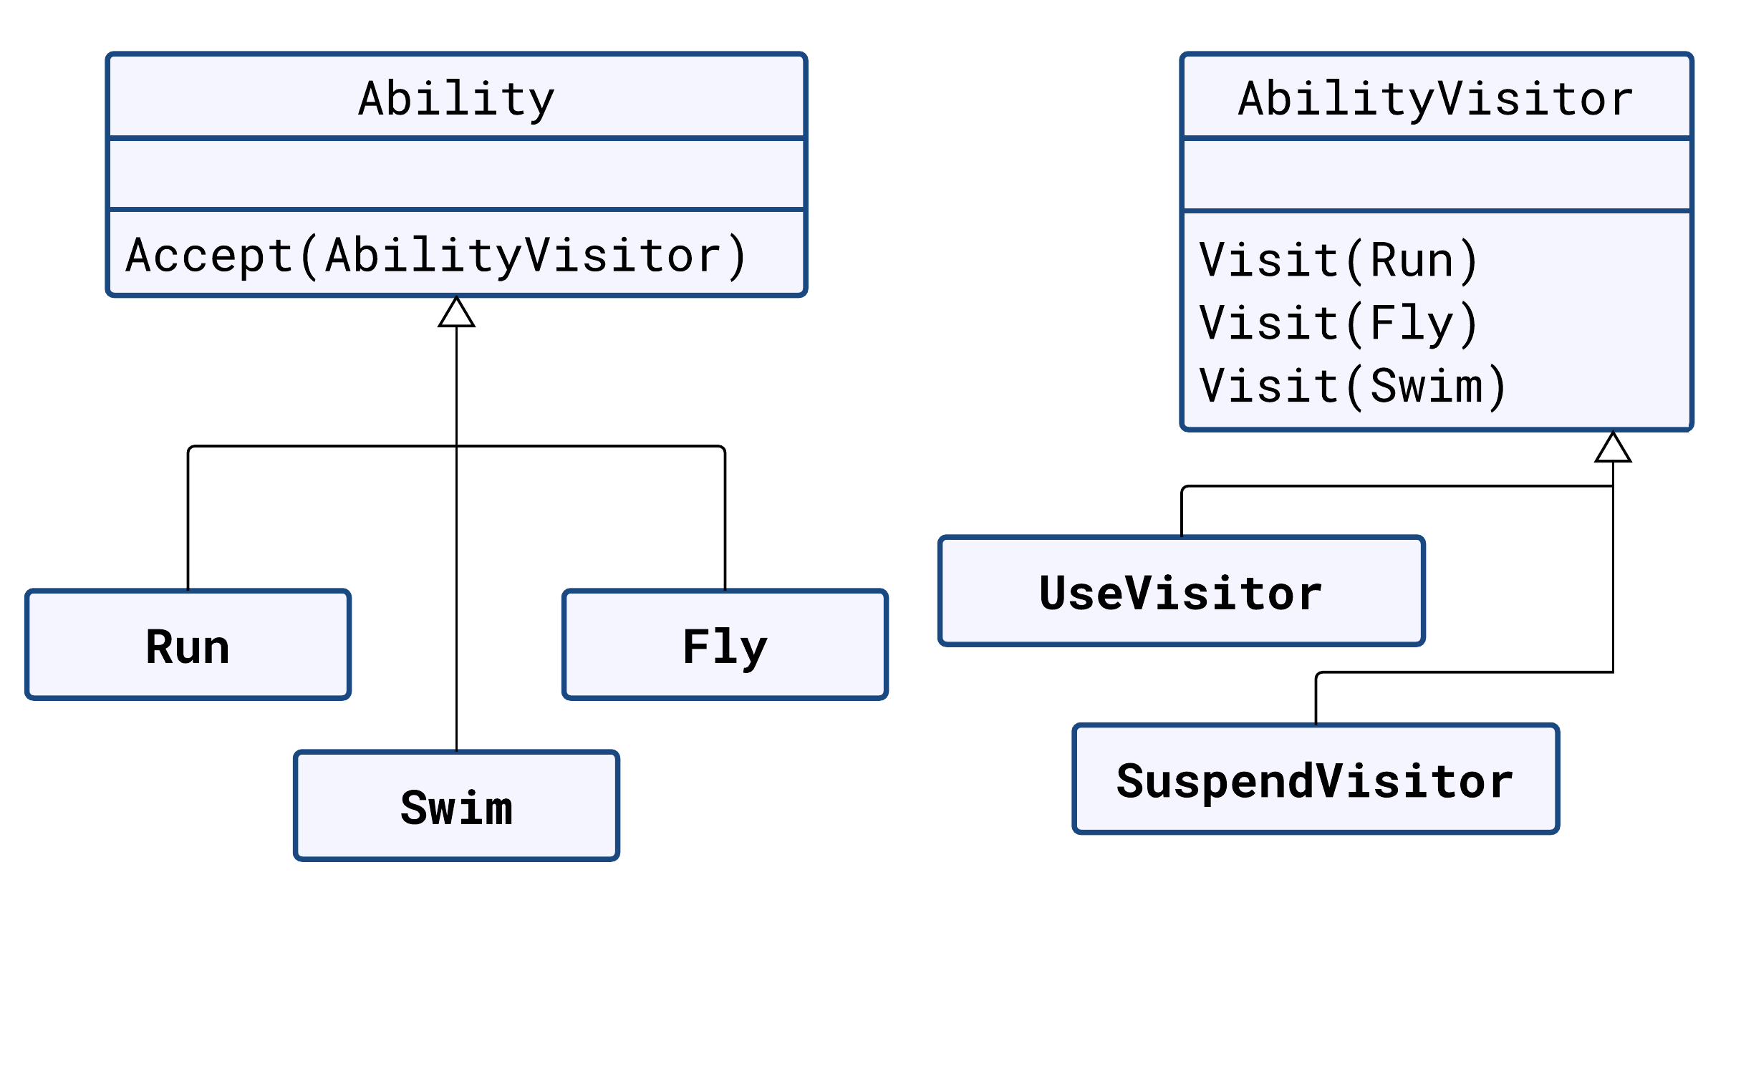

Slide 65
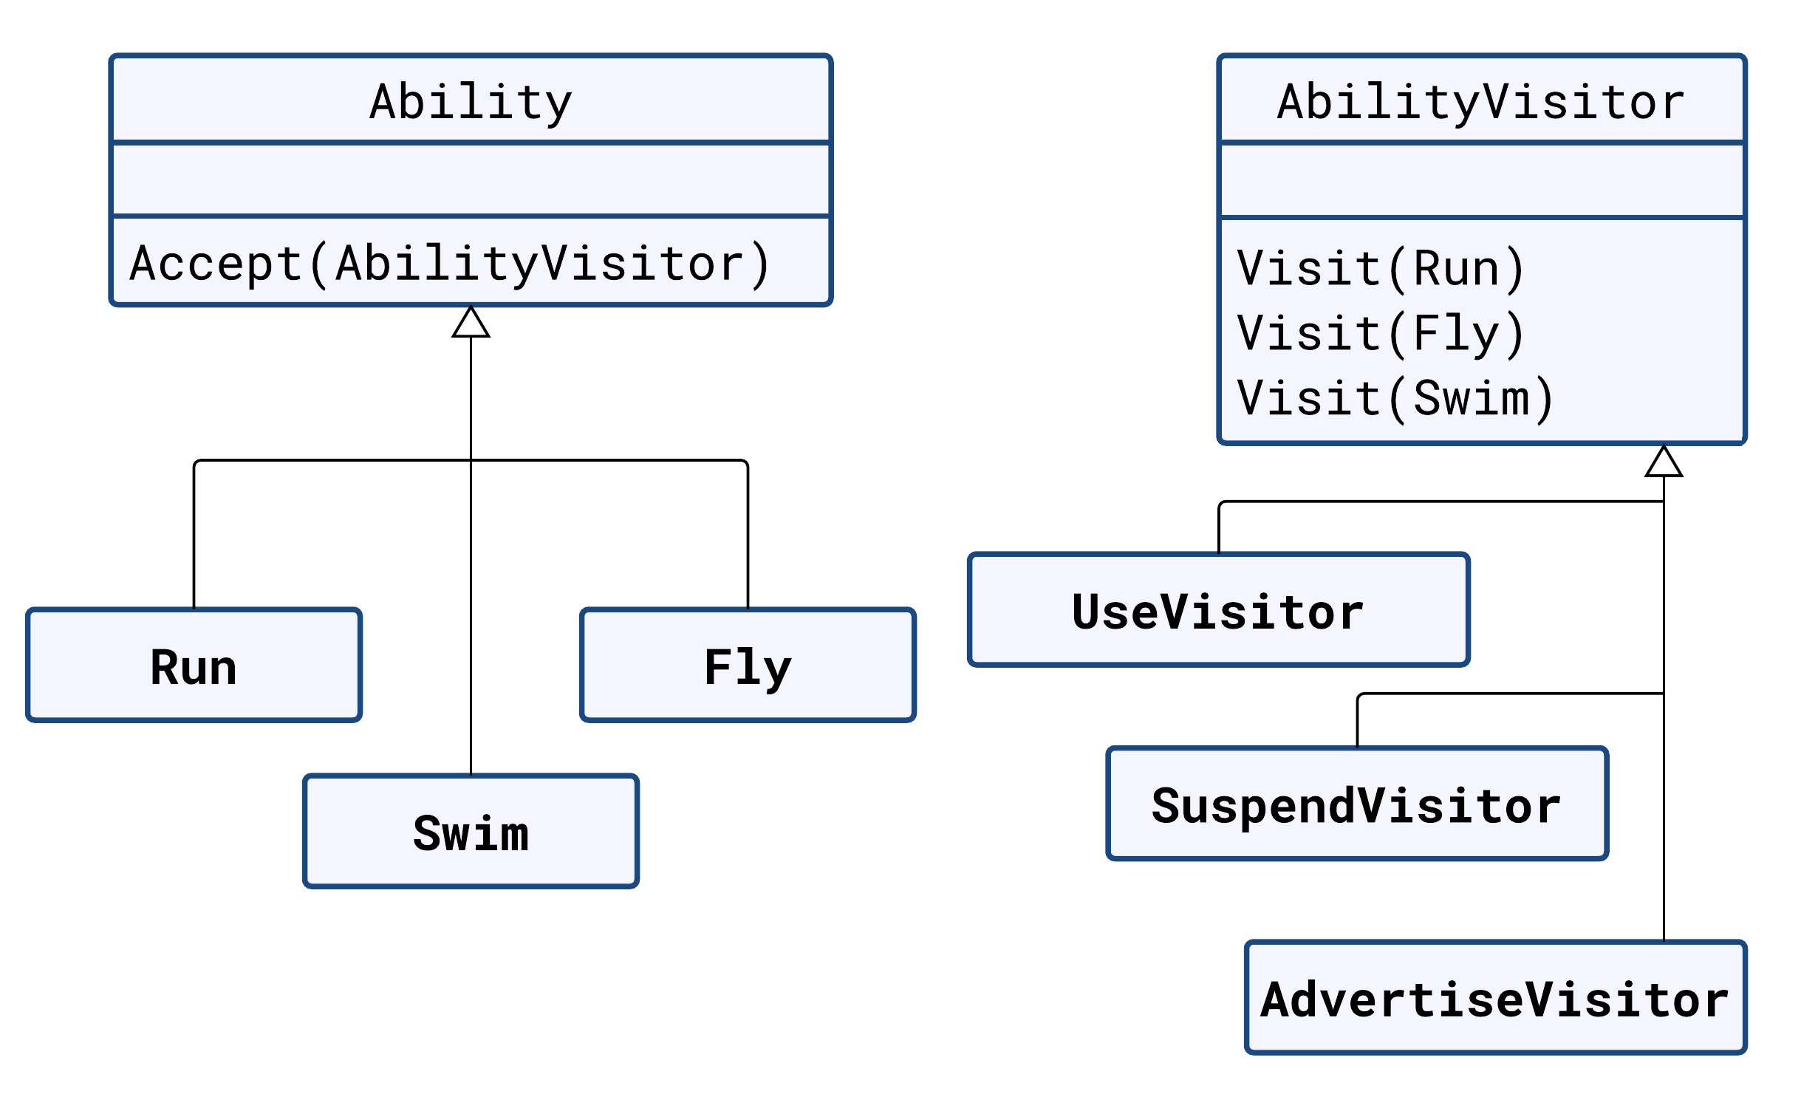
Double dispatch
ability.Accept(visitor);
void Run.Accept(AbilityVisitor visitor)
{
visitor.Accept(this); // Accept(Run)
}

Slide 66
Questions?
Zoran Horvat
CEO & Principal Consultant, Coding Helmet Consultancy
zh@sysexpand.com
http://codinghelmet.com
zoranh75

